Slide 1
Huawei SX7 Campus Switches Configuration Quotation Guide (Overseas)

Slide 2
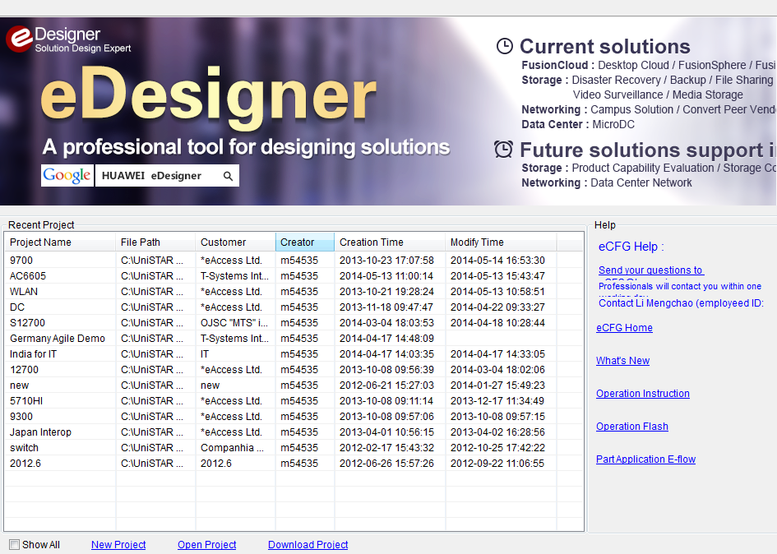
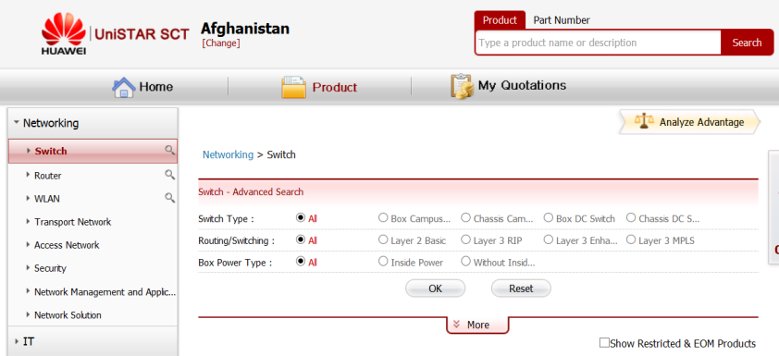
Tools
UniSTAR eCFG
  Customized
  Description: Offline quotation tool
  Training material (channel)
UniSTAR SCT
  Web-based
  Description: Simplified online quotation tool (only this tool will be provided in future)
  SCT
  Training material
  * The underlined content indicates the material links.

Slide 3
Contents
1.
Campus Switch SX7 Series Family
2.
Chassis Switch Configuration Guide
3.
Box Switch Configuration Guide

Slide 4
Sx7 Series Switches
Product Type | Product Name | Description
Core switch | S12700 | Agile chassis switch
 | S9700 | Chassis T-bit core routing switch, which can be upgraded to an agile switch
Aggregation switch | S7700 | Chassis aggregation switch, which can be upgraded to an agile switch
 | S6700 | Data center 10GE switch
1000M access switch | 5720HI | Agile box switch
 | S5700HI/S5710HI/S5710EI | MPLS multi-service switch
 | S5700EI | Enhanced Layer 3 switch
 | S5700SI | Standard Layer 3 switch
 | S5700LI | Simplified Layer 2 switch
100M access switch | S3700EI | Enhanced Layer 3 switch
 | S3700SI | Standard Layer 3 switch
 | S2700EI/S2720EI/S2750EI | Enhanced 100M Layer 2 switch
 | S2700SI | Standard 100M Layer 2 switch
SMB switch | S1700/S1720 | SMB switch

Slide 5
Product Orientation
S12700 | S9700 | S7700 | S6700 | S5720-HI | S5700 SI/EI/HI | S5700 LI | S3700 | S2700
Core | Core | Core of small- and middle-sized networks Aggregation of large-sized networks | 10GE aggregation Data center access | Branch core Access/aggregation of campus | Access Aggregation of small- and middle-sized networks | Access Aggregation of small- and middle-sized networks | Access (distributor, low price) | Access (distributor, low price)
100M/ 1000M/ 10G/40G/100G | 100/ 1000M/ 10G/40G/100G | 100/1000M / 10G/40G/100G | 10G/1000M | 10G/1000M | 10G/1000M | 10G/1000M | 1000M/100M | 1000M/ 100M
L2/L3 | L2/L3 | L2/L3 | L2/L3 | L3 | L3 | L2 | L3 | L2
Chassis | Chassis | Chassis | Box | Box | Box | Box | Box | Box

Slide 6
Contents
1.
Campus Switch SX7 Series Family
2.
Chassis Switch Configuration Guide
3.
Box Switch Configuration Guide

Slide 7
Contents
S12700 Configuration Guide
S9700 Configuration Guide
S7700 Configuration Guide

Slide 8
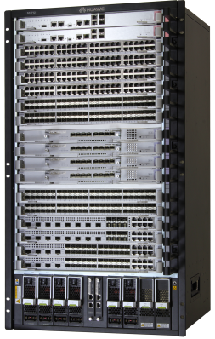

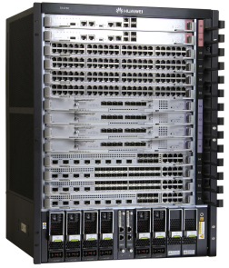
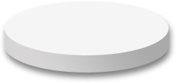
S12700 Configuration
Chassis
LPU
Optical module
Software and license
Cluster cable
Installation auxiliaries
Others
S12712
S12708

Slide 9
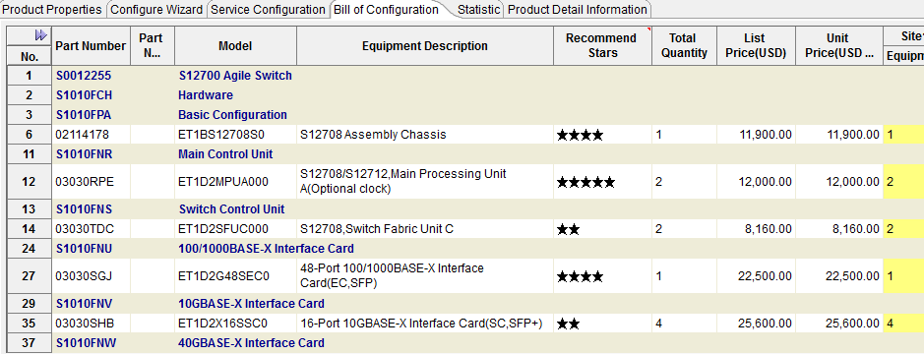
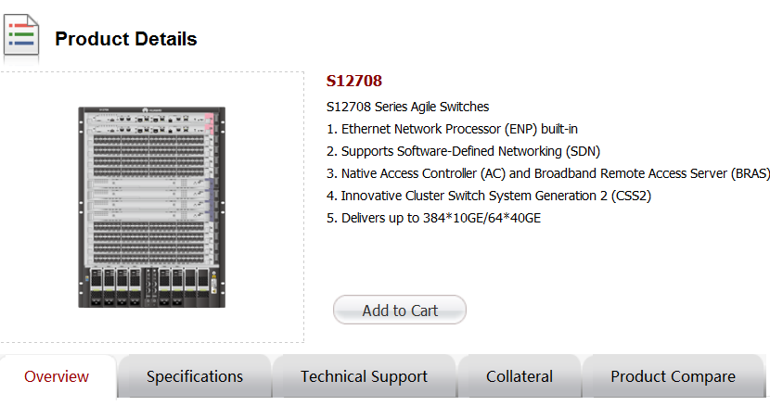
Chassis
Chassis
LPU
Optical module
Software and license
Cluster cable
Installation auxiliaries
Others
UniSTAR eCFG
Basic configuration
  Chassis
  Installation suite
MPU
  MPUA
SFU
  SFUA, SFUC, SFUD
CMU
  CMU
Power supply
UniSTAR SCT
When a product is added to UniSTAR SCT, the chassis type is determined. You can select one from multiple options.

Slide 10
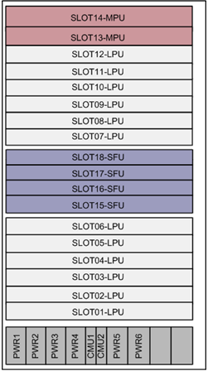
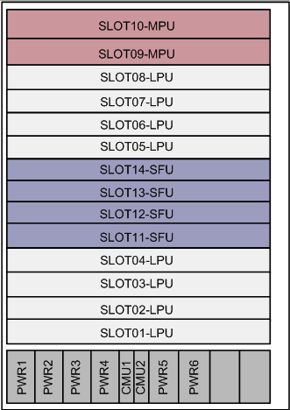
Integrated Chassis
Chassis
LPU
Optical module
Software and license
Cluster cable
Installation auxiliaries
Others
Configuration Tips
The integrated chassis can be installed in a 19-inch cabinet or not installed in a cabinet.
The power module is located in bottom of the debugging integrated equipment. It is the mandatory component of the S12700 chassis.
All components support redundancy and hot-swapping.
AC and DC power supplies are supported, but only the power supplies of the same type can be installed on the same device. The AC and DC power supplies cannot be installed on a device. PoE is not supported.
S12708
S12712
Description | MPU | LPUs | SFUs | Power Slots | CMU | Max Power Consumption | Dimensions
S12708 chassis | 1+1 | 8 | 4 | 6 | 1+1 | <= 4400W | 442 mm x 489 mm x 663.95 mm (15U)
S12712 chassis |  | 12 | 4 | 6 |  | <= 6600W | 442 mm x 489 mm x 841.75 mm (19U)
Notes:
The power modules support PoE. The PoE function supports only the AC power supply and does not support the backup of power modules.

Slide 11
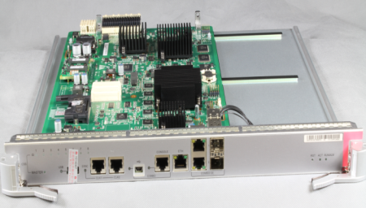
New MPU: MPUA
Chassis
LPU
Optical module
Software and license
Cluster cable
Installation auxiliaries
Others
MPUA Overview
  MPUs of S12700 series are interchangeable
Function overview
  CSS Combo port supports long-distance CSS through control plane.
  Hardware OAM/BFD
  Layered traffic shaping
  USB-based deployment during which indicators show system status
Function | S12700 | Competitor
Hardware BFD (50ms failover) | Supported | Not supported
CSS status indicator | Supported | Not supported
CSS ID indicator | Supported | Not supported
USB deployment | Supported | Not supported
Control plan CSS | Supported | Not supported
USB port
Management port
Clock port
Cluster Combo port
Combo port:
Mini USB or RJ45
CSS Master indicator: If the indicator is on, the card is active; if the indicator is off, the card is standby.
CSS ID: Eight indicators. If the indicator is on, it indicates the chassis ID in CSS.
  Configuration tips: The dual control boards in 1+1 hot standby mode are recommended to improve system reliability.

Slide 12
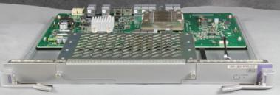
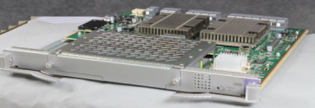
New SFU
Chassis
LPU
Optical module
Software and license
Cluster cable
Installation auxiliaries
Others
SFUA
SFU Overview
  Universal SFU of S12700 series
Card overview
  Three types, SFUA, SFUC, and SFUD are provided. When cards are fully configured, each slot delivers 160-640 Gbps bandwidth, which can reach 1.28 Tbps.
  The SFUs are selected according to switching bandwidth. SFUs are not interchangeable.
  The CSS bandwidth is 640 Gbps, which can be upgraded to 1.92 Tbps.
CSS card slot
OFL button
SFUD
  Note: When SFUA cards are fully configured on an S12708, a golden bandwidth of 480 Gbps is delivered.
★
  Note: S12712 does not support SFUC.
★
Design highlights
  OFL button: Press the OFL button to switch traffic to the other SFUs to ensure uninterrupted traffic forwarding.
  Dual control channels: The system automatically detects faults and performs failover.
CSS card slot
OFL button
  Configuration tips:
  S12708 supports SFUA, SFUC, and SFUD. S12712 supports SFUA and SFUD. The SFUs of different types cannot be installed on the same chassis.
  Each chassis can have at least one SFU and at most four SFUs installed.

Slide 13
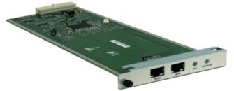
Independent CMU Provides Uniform and Dynamic Monitoring
Chassis
LPU
Optical module
Software and license
Cluster cable
Installation auxiliaries
Others
CMU
Four Major Functions
Intelligent diagnosis and location
Detects voltage and temperature of LPUs
Detects faults in LPU clock
Assets management
Manages component status
Manages component types
Records power-on time of LPUs
Monitors service plane environment changes independently
Independent service monitoring
Dynamic power control
Controls power of LPUs
Controls fan speed based on areas, to reduce noise and power consumption
  Configuration tips: The chassis contains a CMU. A redundant CMU can be selected to improve system reliability.

Slide 14
Power Supply
Chassis
LPU
Optical module
Software and license
Cluster cable
Installation auxiliaries
Others
S12700 supports 2200 W AC and DC power supplies. The power supplies can be configured in N+M mode.
Each of S12708 and S12712 supports six power supplies. The S12700 chassis does not support PoE. The following table describes the power supply specifications of S12700.
Chassis Model | Chassis Specifications | Power Configuration
 |  | Maximum Output Power (Rated Voltage: -48V DC, 220V AC Input) |  | PoE Power | Remarks
S12708 chassis | 15 U, 442 mm x 489 mm x 663.95 mm (width x depth x height) MPUs in 1+1 mode CMUs in 1+1 mode, one CMU included by default A maximum of 4400 W power consumption of the entire chassis | 2200 W DC | 1+1: 2200 W output 2+2: 4400 W output | Not supported | 110 V AC input, output power reduced by a half Six power supplies in N+M mode (1+1, 2+1, 2+2, 3+1, 3+2, 3+3) 4400 W power consumption in V2R5, N+1 power backup recommended
 |  | 2200 W AC | 1+1: 2200 W output 2+2: 4400 W output
S12712 chassis | 19U, 442 mm x 489 mm x 841.75 mm (width x depth x height) MPUs in 1+1 mode CMUs in 1+1 mode, one CMU included by default A maximum of 6600 W power consumption of the entire chassis | 2200 W DC | 1+1: 2200 W output 2+2: 4400 W output 3+3: 6600 W output | Not supported | 110 V AC input, output power reduced by a half Six power supplies in N+M mode (1+1, 2+1, 2+2, 3+1, 3+2, 3+3) 6600 W power consumption in V2R5, N+1 power backup recommended
 |  | 2200 W AC | 1+1: 2200 W output 2+2: 4400 W output 3+3: 6600 W output
Configuration tips:
S12708/S12712 has the SFUA configured. The total number of LPUs and SFUAs should be greater than or equivalent to 2 and smaller than or equivalent to 16. It is recommended to configure two power supplies.
S12708/S12712 has the SFUC/SFUD configured. The total number of LPUs and SFUCs should be greater than or equivalent to 2 and smaller than or equivalent to 8. It is recommended to configure two power supplies. The total number of LPUs and SFUDs should be greater than or equivalent to 8 and smaller than or equivalent to 16. It is recommended to configure three power supplies.
To obtain detailed power consumption data, use the S12700 Power Consumption Calculator. The calculated power consumption includes the power consumption of optical modules.

Slide 15
S12700 Configuration
Chassis
LPU
Optical module
Software and license
Cluster cable
Installation auxiliaries
Others
S12712
S12708

Slide 16
S12700 LPU
Chassis
LPU
Optical module
Software and license
Cluster cable
Installation auxiliaries
Others
LPUs are selected based on interface types, MAC addresses, whether MPLS and unicast are supported, multicast routing table size, and whether cluster is supported.
Card Type | MAC | MPLS | Interface Type | FIB | ARP | Remarks
X1E | 1M | Y | 48*GE electrical/optical 4*10GE(SFP+)+24GE optical+8 combo 8*10GE(SFP+)+8GE optical+8 combo | 256K by default | 256K | This card provides agile features. The card implements native AC, unified user management, iPCA, large buffer, large table, and NetStream.
SA | 32K | N | 12*10GE optical (SFP+) | 12K | 8K
EA | 32K | Y | 48*GE electrical/optical 36*GE electrical+12*GE optical 4*10GE optical (XFP( | 16K | 16K
EC | 128K | Y | 48*GE electrical/optical 4*10GE optical (XF) 24*GE optical 48*10GE optical (SFP+) | 128K | 16K
SC | 128K | Y | 16*10GE (SFP+) 2*40GE (QSFP+) 8*40GE (QSFP+) | 16K | 8K (16*10GE) 16K (2*40GE, 8*40GE)
The service cards are installed in the LPU slots, and can be used by both models of S12700. A maximum of 12 LPUs can be configured for S12712 and 8 LPUs can be configured for S12708.
You can select LPUs according to your service requirements and LPUs' features. Enter the number of required LPUs in the list.

Slide 17
S12700 Special LPUs
Chassis
LPU
Optical module
Software and license
Cluster cable
Installation auxiliaries
Others
S12700 provides multiple special LPUs for your selection.
Part Number/Model | Type | Function | Remarks
03030NWB/ EH1D200CMU00 | CMU | Monitors and manages the power in the chassis Monitors and manages fans | S912708/12712 supports CMUs in 1+1 mode. The chassis includes one CMU. You can configure a redundant CMU.
ET1D2FW00S00 | Firewall board-10G | Firewall NAT IPSec VPN Load Balance
ET1D2FW00S01 | Firewall board-20G | Firewall NAT IPSec VPN Load Balance
ET1D2FW00S02 | Firewall board-40G | Firewall NAT IPSec VPN Load Balance
EH1D2IPS0S00 | IPS board | IPS protection
03021UWH /EH1D2VS08000 | 8-Port 10G Cluster Switching System Service Unit (SFP+) | S12700 cluster subcard | Used together with SFU
03022HXD/LE2D2FW00W02 | Wireless access control board (ACU2) | Supports WLAN AC

Slide 18
S12700 Configuration
Chassis
LPU
Optical module
Software and license
Cluster cable
Installation auxiliaries
Others
S12712
S12708

Slide 19
Optical Module
Chassis
LPU
Optical module
Software and license
Cluster cable
Installation auxiliaries
Others
Type | Optical Module | Connector
SFP | FE | Peer port (onsite survey required) LC/PC SC/PC FC/PC ST/PC If transmission distance is longer than 40km, XFP is recommended.
eSFP | FE
 | FE BIDI
 | GE
 | GE BIDI
 | POS
 | GE CWDM (not supported)
 | GE DWDM (not supported)
 | GE Electrical port module FE
SFP+ | 10GE
XFP | 10GE
 | 10GE CWDM
 | 10GE DWDM
QSFP+ | 40GE | MPO <300m multi-mode LC < 10Km Single-mode
Precautions
The optical modules on two ends must have three identical parameters:
  Transmission distance
  Mode: single or dual
  Center wavelength
Interpretability: SFP+ ←→ XFP
All FE and GE optical cards are hot swappable.
When a cluster is set up through fibers, the QSFP+ modules need to be configured.
BIDI: wavelengths on two ends match
TX1490/ RX1310 ←→ TX1310/ RX1490
CWDM optical module
Connects switches to WDM
Supports all 10G XFP LPUs, but does not support SFP+ LPU
*BIDI –single-core bidirectional

Slide 20
S12700 Optical Module Use Precautions
Chassis
LPU
Optical module
Software and license
Cluster cable
Installation auxiliaries
Others
Pay attention to three specifications when selecting optical modules: transmission distance, connection attributes (such as single-mode/multimode of fibers and optical modules), and center wavelength. When two devices are connected, ensure that interfaces on both devices have the same indexes, such as the transmission distance, interconnection attributes, and center wavelength.
Most single-mode optical modules configured for the S12700 support the "wide range receiving" feature. That is, optical signals, with the center wavelength of either 1310 nm or 1550 nm, can be received normally, but some optical modules can work normally only within a narrow range of center wavelength. Therefore, it is recommended that the center wavelengths of the optical modules on both devices be the same. When the S12700 is connected to a non-Huawei device, note that the optical modules of non-Huawei device may not support the "wide range receiving" feature.
If the transmission distances of the optical modules on the connected devices differ greatly, the receiver of the optical module with the shorter transmission distance may be overloaded. This affects signal transmission reliability. Avoid this situation. If this situation cannot be avoided, configure an optical attenuator on the receiver with the shorter transmission distance. In addition, it is recommended to design for optical transmission during the networking to ensure reliable interoperation between devices.
The optical interface boards of S12700 support hot swappable CWDM optical modules. CWDM optical modules must use the same wavelengths; otherwise, they cannot communicate with each other. When the switch is connected to WDM, the CWDM optical modules need to be used. The wavelengths and quantity of optical modules depend on the contract. To connect Ethernet devices, common optical modules are preferred.
The single-fiber bidirectional optical modules must be used in pairs. Tx indicates the transmit wavelength and Rx indicates the receive wavelength. An optical module has the following wavelengths:
Optical Transceiver-SFP-Tx1310/Rx1490-1.25Gb/s--3dBm--9dBm--19.5dBm-LC-Single-mode-10km
Optical Transceiver-SFP-Tx1490/Rx1310-1.25Gb/s--3dBm--9dBm--19.5dBm-LC-Single-mode-10km

Slide 21
S12700 Configuration
Chassis
LPU
Optical module
Software and license
Cluster cable
Installation auxiliaries
Others
S12712
S12708

Slide 22
Software and License Configuration
Chassis
LPU
Optical module
Software and license
Cluster cable
Installation auxiliaries
Others
Part Number | Description | Configuration
05160692 | S12700 V200R005C00 Software Package | Select a software package according to customer needs. By default, the mainstream software package in the supply chain is delivered.
81400500 | MPLS Function License | Configured according to customer needs.
81400501 | NQA Function License | Configured according to customer needs.
81400502 | IPV6 Function License | Configured according to customer needs.
82400519 | X-series LPU FIB Resource License-128K | 256K by default Configured according to customer needs. When more licenses are purchased, resources are accumulated.
82400520 | X-series LPU FIB Resource License-512K
82400503 | WLAN Access Controller AP Resource License-512AP (with the X-series LPU used) | 16 APs by default Configured according to customer needs. When more licenses are purchased, resources are accumulated.
82400504 | WLAN Access Controller AP Resource License-128AP (with the X-series LPU used)
82400505 | WLAN Access Controller AP Resource License-64AP (with the X-series LPU used)
82400506 | WLAN Access Controller AP Resource License-16AP (with the X-series LPU used)

Slide 23
S12700 Configuration
Chassis
LPU
Optical module
Software and license
Cluster cable
Installation auxiliaries
Others
S12712
S12708

Slide 24
Cluster Cable: The Only Hardware-based CSS2 in Industry
Chassis
LPU
Optical module
Software and license
Cluster cable
Installation auxiliaries
Others
S12700 switches form a cluster through CSS2 technique. Two switches are logically connected to form a large-capacity switch.
Currently, cluster is implemented through the cluster subcards.
Hardware cluster at the switching plane
Hardware cluster at the control plane
Hardware cluster at dual planes
Control channel
Cluster cable
Control channel
Cluster cable
=
Power bus
Power bus
Power bus
Power bus
MPU in standby chassis
+
MPU in active chassis
MPU in standby chassis
MPU in active chassis
MPU in active chassis
MPU in standby chassis
CMU
CMU
CMU
CMU
SFU
SFU
SFU
SFU
LPU
LPU
LPU
LPU
SFU
SFU
LPU
SFU
SFU
LPU
LPU
LPU
  High reliability: Industry-leading switch fabric hardware clustering technology. Control packets and data packets of a cluster only need to be forwarded once by the SFUs. Control packets can be transmitted through specialized hardware channels. When the control link is faulty, services can be switched from the control plane to the forwarding plane. The dual-plane hardware clustering is more reliable.
  Easy-to-use: Any interface on one chassis in the forwarding plane can establish a cluster with interfaces on any cluster card of the other chassis, and any interface on one chassis in the control plane can establish a cluster with interfaces on the other chassis, without occupying service slots.
  Innovation: 1+N backup of control boards, implementing single-MPU cluster
  Low-delay, high-bandwidth: reduces inter-chassis forwarding latency to 21 us, which is 58% lower than industry average. Cluster bandwidth can reach 1.92 Tbps.
★CSS2: Cluster Switch System Generation2

Slide 25
Cluster Cable Configuration
Chassis
LPU
Optical module
Software and license
Cluster cable
Installation auxiliaries
Others
CSS2 forwarding model
When VS08 is installed on the SFU of S12712/S12708 as a cluster subcard (the cables of cluster subcards need to be configured independently), a maximum of four cluster subcards can be configured. The cluster subcard is installed on SFU. A cluster subcard provides eight SFP+ interfaces.
CSS2 configuration scheme:
Cluster subcards: 1-4
Cable cluster: A maximum of 32 SFP+ cables can be included. There are three cable lengths for selection: 1m, 3m, and 10m.
Fiber cluster: The SFP+ optical modules can be used. A maximum of 80 km distance is supported. For short-distance transmission, the low-cost SFP+ AOC module which is equipped with fibers can be used. The transmission distance of this module is 10m.
Data packets
Cluster cable
SFU
SFU
LPU
LPU
LPU
LPU
Chassis 1
Chassis 2
The CSS2 can be implemented using cables or fibers. SFP+ cables, SFP+ optical modules, and AOC cables are supported.
Part Number | Description | Remarks
02310MUN | SFP+,10G,High Speed Direct-attach Cables,1m,SFP+20M,CC8P0.254B(S),SFP+20M,Used indoor | 1m: SFP+<->SFP+, high-speed cable
02310MUP | SFP+,10G,High Speed Direct-attach Cables,3m,SFP+20M,CC8P0.254B(S),SFP+20M,Used indoor | 3m: SFP+<->SFP+, high-speed cable (not support 12 GE ports)
02310MUQ | SFP+,10G,Active High Speed Cables,10m,SFP+20M,CC8P0.32B(S),SFP+20M,Used indoor | 10m: SFP+<->SFP+, high-speed cable
02310QWG | AOC Optical Transceiver,SFP+,850nm,1G~10G,0.003km | 3m, connects 10G SFP+ port to 10G SFP+ port
02310QWH | AOC Optical Transceiver,SFP+,850nm,1G~10G,0.01km | 10m, connects 10G SFP+ port to 10G SFP+ port

Slide 26
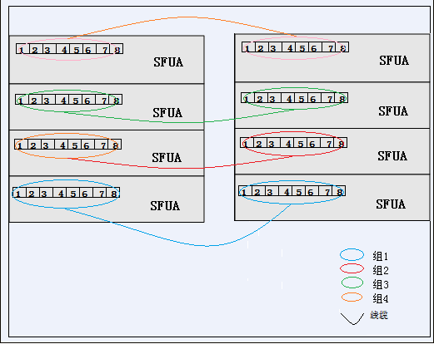
Cluster Cable Configuration
Chassis
LPU
Optical module
Software and license
Cluster cable
Installation auxiliaries
Others
CSS2 Connection Rule
Precautions
Assume that 8 ports on a cluster subcard belong to a group. The cluster subcards are connected according to the following rules:
The 8 ports on one cluster subcard must be connected to the 8 ports on another subcard. It is recommended to connect the ports with the same port number together.
When a cluster has only one cluster subcard, at least one SFP+ port can be used.

Slide 27
S12700 Configuration
Chassis
LPU
Optical module
Software and license
Cluster cable
Installation auxiliaries
Others
S12712
S12708

Slide 28
Installation Auxiliaries Configuration
Chassis
LPU
Optical module
Software and license
Cluster cable
Installation auxiliaries
Others
Select fibers
To configure fibers for a non-BIDI optical module, configure a Tx optical fiber and an Rx optical fiber of the same type for each optical interface. To configure fibers for a BIDI optical module, configure only one optical fiber. If single-mode optical modules are used, configure single-mode fibers. If multimode optical modules are used, configure multimode fibers. You can select fibers of different lengths. Huawei provides fibers of 10 m, 20 m, and 30 m.
Select network cables
Select cables
Each network cable has two RJ45 connectors configured (part number: 14080082).
You can select cable length according to customer requirements.
The length of network cables is determined according to user requirements. The price increases for every 1 m increase in length (part number 25050014).
External cables used for assemble chassis (desk installation)
a. No cabinet is used. The assembly chassis obtains power from customer's PDF.
External cables used for assemble cabinet (with a power distribution box)
b. The cabinet and power distribution box obtain power from the customer's PDF, and provide power to the power modules.

Slide 29
Cable Configuration
Chassis
LPU
Optical module
Software and license
Cluster cable
Installation auxiliaries
Others
Desktop installation
Power module | Maximum air breaker current | Power cable
2200W DC (02270117) | 60A | The cables are quoted. When the maximum input current of power module is 60 A, the cables are selected based on the distance between the chassis and PDF: 1. Within 14 meters: 10 mm blue and black power cables 2. Within 23 meters: 16 mm blue and black power cables 3. Within 36 meters: 25 mm blue and black power cables 3. Longer than 36 meters: notify the customer that a power distribution box is required
2200W AC (02131120) | 15.5A | Delivered according to contract: (04000207) External Suite,Power Cords All Over The World,Class I Equipment With Connector C19,External Cable Set. One cable is delivered for each power module. By default, the 3 m cable is delivered.
Note:
The price of cables is included in the quotation of DC power module. By default, Huawei provides blue (-48 V) and black (GND) cables. If the customer needs other cables, the requirement should be added to the contract, and the cables may be purchased locally or from Huawei headquarters.
If the customer has not chosen cabinet and power distribution box, Huawei delivers a 3 m AC power cable for the AC power module. The power cable model is selected by Huawei according to standards in the corresponding country.
Power distribution box
Cabinet model | Power distribution box specifications | Matching power modules | External power cable
N68- AC Assembly Rack (02113563) | Input/output: 2 inputs, 4 outputs Air breaker: 16 A x 4 | 4PCS (2200W AC) | Select the AC power cable with black PVC color (three core colors: blue, brown, and yellow/green) according to the distance between cabinet and PDF: 1. Within 13 meters: 6 mm AC power cables 2. Within 35 meters: 16 mm AC power cables
N68- DC Assembly Rack (02113562) | Input and output: 8 inputs, 8 outputs (4 inputs, 8 outputs implemented by using copper bar) Air breaker: 63 A x 8 | 8PCS (2200W DC) | The maximum input power of the power distribution box is 63 A in the case of 8 inputs and 8 outputs. The cables are selected based on the distance between the chassis and PDF: 1. Within 18 meters: 16 mm blue and black power cables 2. Within 29 meters: 25 mm blue and black power cables 3. Within 41 meters: 35 mm blue and black power cables Note: If the air breaker current must reach 126 A in the case of 4 inputs and 8 outputs, only 35 mm blue and black power cable can be used and the powering distance is within 20 meters.

Slide 30
S12700 Configuration
Chassis
LPU
Optical module
Software and license
Cluster cable
Installation auxiliaries
Others
S12712
S12708

Slide 31
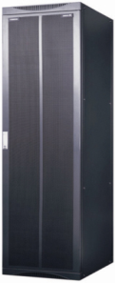
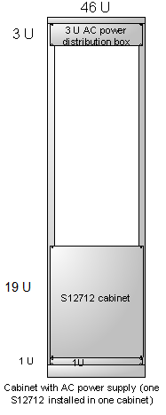
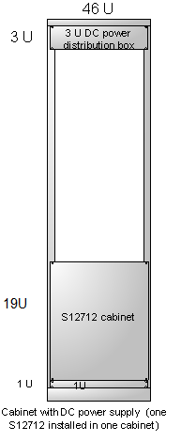
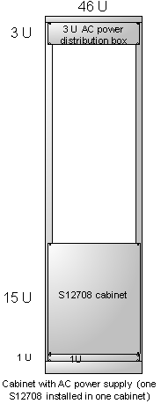
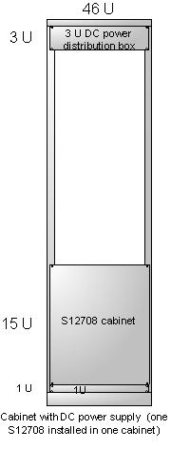
Cabinet: N66E
Chassis
LPU
Optical module
Software and license
Cluster cable
Installation auxiliaries
Others
S12712 one chassis in one cabinet
S12708 one chassis in one cabinet
Precautions
Standard 19-inch cabinet N66E
D*W*H: 600 x 600 x 2200 mm
Two enhanced cabinets: DC enhanced cabinet and AC enhanced cabinet
DC cabinet provides 8-channel 60 A output. Each channel provides 2200 W output. The power distribution box provides 8-input-8-output or 4-input-8-output.
AC cabinet provides 4-channel 16 A output. Each channel provides 2500 W output. By default, the power distribution box provides 2-input-4-output.
The cabinet has a power distribution box equipped. Each channel of the power distribution box serves a power supply. If the number of power supplies is larger than the channels of a power distribution box, more power distribution boxes need to be configured.
When the N68E cabinet (applicable to NE40E) is used, the power distribution box and external cables need to be configured.
Installed on concrete floor or ESD floor.
When the cabinet is installed on the ESD floor, the installation suite is required.
ESD floor installation suite
21150568 | EN6XUSM01 | Mount Kit I | Adjustable height 296-465 mm | Installation height in the equipment room where ESD floor is installed: distance between floor and cabinet
21150569 | EN6XUSM02 | Mount Kit II | (Height >= 150 mm)
Notes:
Cabinet
PTO/POC/ATO/AOC are in the model list. The combination is flexible, so the processing methods are different.
AI and PH sold after being processed by supply chain. A corresponding price is on the quotation list.
SI and P are purchased by Huawei.
SW-software fee

Slide 32
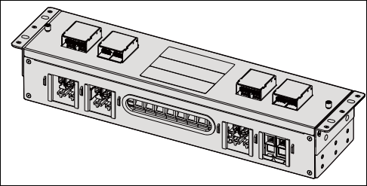
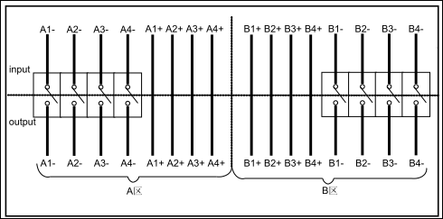
Power Distribution Box
Chassis
LPU
Optical module
Software and license
Cluster cable
Installation auxiliaries
Others
The power distribution box is an important part of a cabinet. It implements centralized power management, and is a mandatory component of the assembly cabinet.
1. 2200W DC power distribution box
The 2200 W DC power distribution box provides 8-channel DC inputs (4-channel DC inputs can be implemented by adding copper fitting. The maximum input current should reach 120 A.). The 8-channel circuit breakers control 8-channel power outputs (each circuit breaker controls 1-channel output). The air breaker current is 63 A.

Slide 33
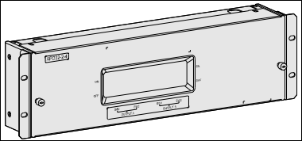
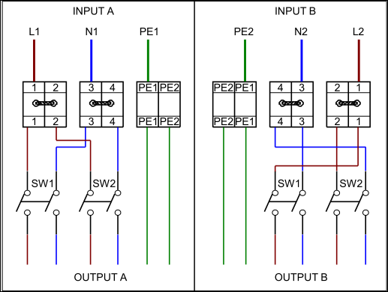
Power Distribution Box
Chassis
LPU
Optical module
Software and license
Cluster cable
Installation auxiliaries
Others
The power distribution box is an important part of a cabinet. It implements centralized power management, and is a mandatory component of the assembly cabinet.
2. 2200W AC power distribution box
The 2200 W AC power distribution box provides 2-channel AC inputs (4-channel AC inputs can be implemented by removing copper fitting). The 4-channel circuit breakers control 4-channel power outputs (each circuit breaker controls 1-channel output). The air breaker current is 16 A.

Slide 34
Contents
S12700 Configuration
S9700 Configuration
S7700 Configuration

Slide 35
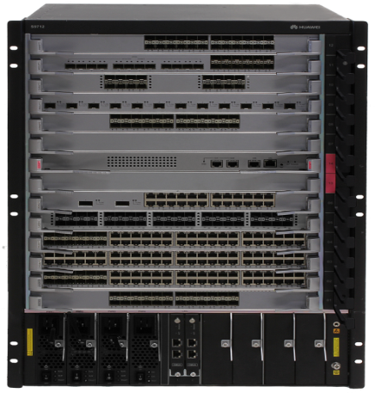
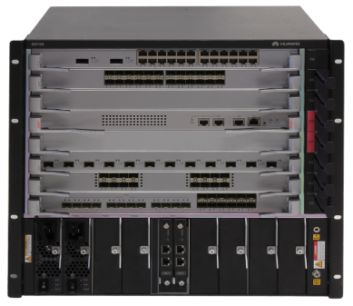
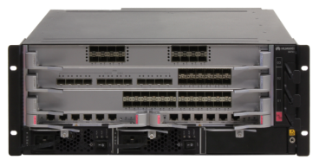
S9700 Configuration
Chassis
LPU
Optical module
Software and license
Installation auxiliaries
S7700
S9703
S9706
S9712

Slide 36
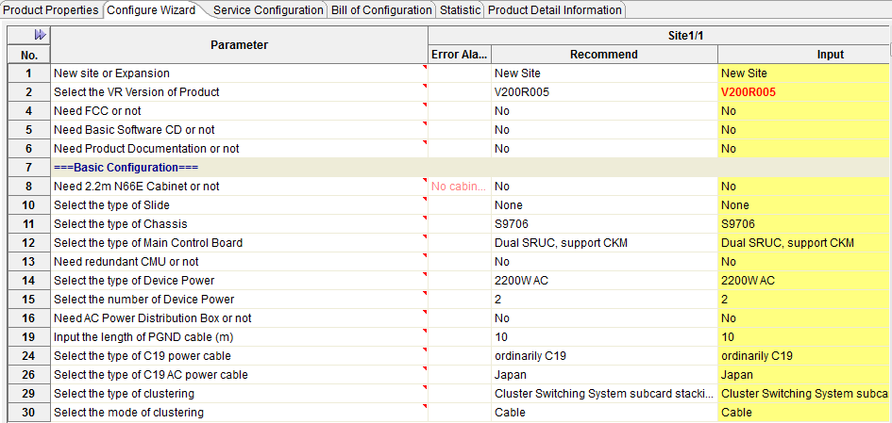
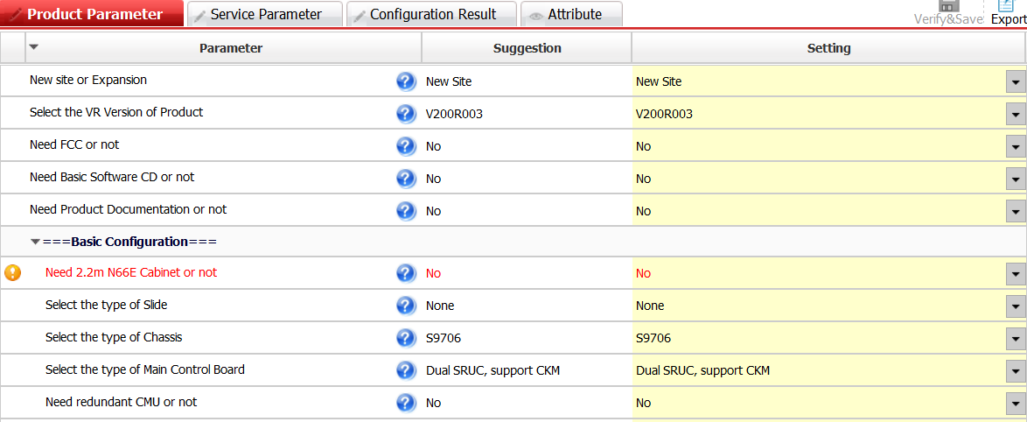
Chassis
Chassis
LPU
Optical module
Software and license
Cluster cable
Installation auxiliaries
Others
UniSTAR eCFG
Basic configuration
  Cabinet
  Chassis
  Installation suite
MPU
  SRU/MCU
CMU
  CMU
Power supply
UniSTAR SCT
When a product is added to UniSTAR SCT, the chassis type is determined. You can select one from multiple options.

Slide 37
Cabinet: N66E
Chassis
LPU
Optical module
Software and license
Cluster cable
Installation auxiliaries
Others
S9712 one chassis in one cabinet
S9706 two chassis in one cabinet
Precautions
Standard 19-inch rack N66E
D*W*H: 600x600x2200 mm
No recommended configuration for S9703. A maximum of four S9703 chassis can be installed in a cabinet.
When the number of quoted 800 W AC power modules exceeds 8, one more power distribution box needs to be configured.
Three models are available: one standard and two enhanced. They differ in power. The models can be selected..
When the N68E cabinet (applicable to NE40E) is used, the power distribution box and external cables need to be quoted for power distribution.
The cabinet can be installed on the concrete floor or ESD floor.
* When the cabinet is installed on the ESD floor, the installation suite is required.
ESD floor installation suite
21150568 | EN6XUSM01 | Mount Kit I | Adjustable height 296-465 mm | Installation height in the equipment room where ESD floor is installed: distance between floor and cabinet
21150569 | EN6XUSM02 | Mount Kit II | 150-296 mm OR > 465mm
Notes:
Cabinet
PTO/POC/ATO/AOC are in the model list. The combination is flexible, so the processing methods are different.
AI and PH sold after being processed by supply chain. A corresponding price is on the quotation list.
SI and P are purchased by Huawei.
SW-software fee

Slide 38
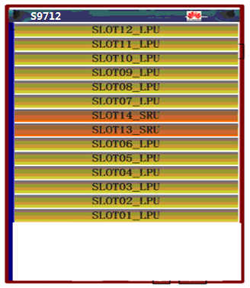
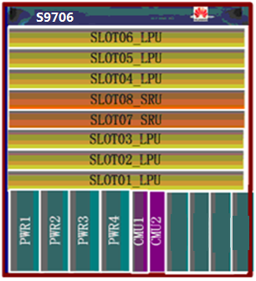
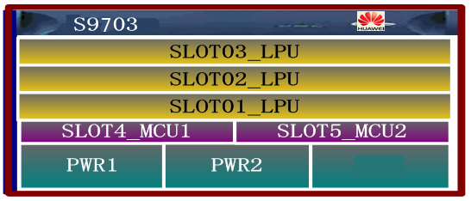



Integrated Chassis
Chassis
LPU
Optical module
Software and license
Cluster cable
Installation auxiliaries
Others
Configuration tips
The integrated chassis can be installed in a 19-inch cabinet or not installed in a cabinet.
All components support redundancy and hot-swapping.
AC and DC power supplies are supported, but only the power supplies of the same type can be installed on the same device. The AC and DC power supplies cannot be installed on a device. PoE is not supported.
Item | MPUs | LPUs | Power Slots | CMUs | Max Power Consumption | Dimensions
S9703 chassis | 1+1 backup | 3 | 2 | CMU is integrated within the cabinet. No independent CMU card is available | <=2200W | 442 x 476 x 175mm (4 U)
S9706 chassis |  | 6 | 4 | 1+1 backup | <=4400W | 442 x 476 x 441.7mm (10 U)
S9712 chassis |  | 12 | 6 |  | <=6600W | 442 x 476 x 663.95mm (15 U)
Notes:
The power modules support PoE. The PoE function supports only the AC power supply and does not support the backup of power modules.

Slide 39
Power Supply
Chassis
LPU
Optical module
Software and license
Cluster cable
Installation auxiliaries
Others
 | Recommended Configuration |  | Remarks
 | PoE is not supported Three types of power supplies are not interchangeable |  | Rated voltage: -48V DC or 220V AC input 110 V AC input, output power reduced by a half
S9703 chassis | 2200 W DC | 1+1: 2200 W output | Max power consumption of the entire chassis: 1100 W One system power supply: supports 1+1 backup
 | 2200 W AC | 1+1: 2200 W output
 | 800 W AC | 1+1: 800 W output
S9706 chassis | 2200 W DC | 1+1: 2200 W output | Max power consumption of the entire chassis: 2200 W Four system power supplies: support M+N backup
 |  | 2+2: 4400 W output
 | 2200 W AC | 1+1: 2200 W output
 |  | 2+2: 4400 W output
 | 800 W AC | 2+1: 1600 W output
 |  | 3+1: 2400 W output
S9712 chassis | 2200 W DC | 1+1: 2200 W output | Max power consumption of the entire chassis: 4400 W Six system power supplies: support M+N backup: 1+1, 2+1, 2+2, 3+1, 3+2, 3+3
 |  | 2+2: 4400 W output
 | 2200 W AC | 1+1: 2200 W output
 |  | 2+2: 4400 W output
 | 800 W AC | 3+1: 2400 W output
 |  | 4+1: 3200 W output
 |  | 5+1: 4000 W output
Calculate the quantity of required power supplies according to total card power consumption

Slide 40
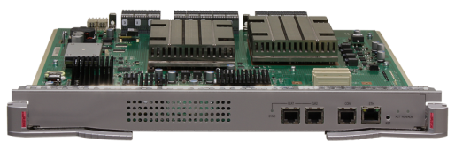
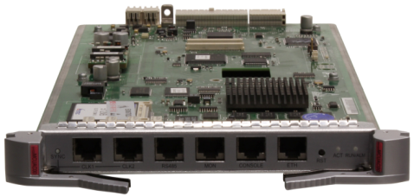
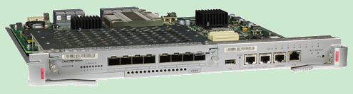
MPU: SRUC/SRUD/MCU
Chassis
LPU
Optical module
Software and license
Cluster cable
Installation auxiliaries
Others
S9706/S9712 MPU-SRUD/SRUC
S9703 MPU-MCU
Hardware-based EOAM/BFD engine
  Max power consumption 180 W
  Integrated SFU
-SRUD
Clock synchronization port (2)
Ethernet port
Console port
Clock synchronization port (2)
Ethernet port
RS485
MON
  Max power consumption 132 W
  Integrated SFU
Console port
No SFU
Integrated monitoring module
Max power consumption 26 W
USB port
Ethernet port
Subcard slot
BITS port (2)
-SRUC
Console port
Configuration tips
  Recommended configuration: MPUs in 1+1 mode
  The chassis includes a clock subcard (installed on the MPU)

Slide 41
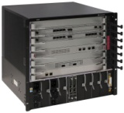
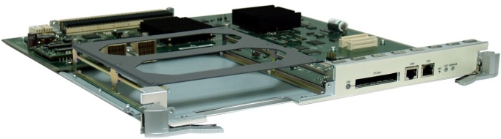
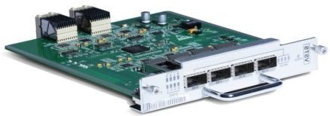
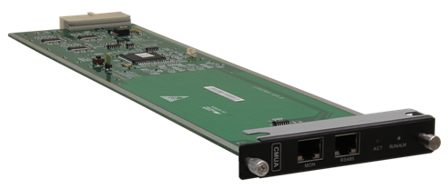
CMU – Center Manage Unit
Chassis
LPU
Optical module
Software and license
Cluster cable
Installation auxiliaries
Others
CSS configuration tips
SRUC is available in V2R3
2013Q2
Only applicable to dual-MPU mode
3 stack scenarios:
  2 S9706
  2 S9712
  1 S9706 vs 1 S9712
A cluster consisting of two chassis, stack cable required:
4 CSS cards * 2 = 8 cables
SRUC
+
CSS
CMU configuration tips
S9703 MCUA with a CMU integrated
S9706 /12 with one CMU configured
One more CMU can be configured to implement 1+1 backup
Suggestion: not needed
CMU faults do not affect service
CMU functions:
Manages power supplies and fans to implement intelligent energy-saving and reduce noise.
CMU

Slide 42
S9700 Configuration
Chassis
LPU
Optical module
Software and license
Installation auxiliaries
S7700
S9703
S9706
S9712

Slide 43
LPU - S/F/E/B
Chassis
LPU
Optical module
Software and license
Cluster cable
Installation auxiliaries
Others
Type | Series | Sub-series | Main Features | Orientation
High-end (Super-large specification) | X1E series | X1E series | Native AC Unified user management iPCA Netstream/MPLS | Suggestion: Aggregation of campus and data center With an X1E card, an S9700 can be upgraded to an agile switch.
Standard (Low specification) | S series | SA LPU | sFlow Not support MPLS Not support external TCAM | Suggestion: Access of campus and data center
 | F series | FA LPU | sFlow MPLS Not support external TCAM
 |  | FC LPU
Enhanced (High specification) | E series | EA LPU | Netstream MPLS External TCAM | Suggestion: Aggregation of campus and data center
 |  | EC LPU
 |  | ED LPU
 | B series | BC LPU | 1.25 GB large buffer Other specifications are the same as those of EC series | Suggestion: Data center and video scenario
Series: S/ E / F /B: function extension Sub-series (default): A: 32K MAC C: 128K MAC D: 512K MAC (The number of MAC address entries, FIB entries, and ACL entries is modified in different scenarios) X1E: MAC 1 MB, FIB: 1 MB (256K by default, which can be expanded using License)

Slide 44
Special LPUs
S9700 provides multiple special LPUs for your selection.
Type | Functions | Remarks
CMU | Monitors and manages the power in the chassis Monitors and manages fans | S9703 does not need CMU S9706/9712 supports CMUs in 1+1 mode. The chassis includes one CMU. You can configure a redundant CMU.
WLAN ACU2 wireless access control card (128 AP) | WLAN AC | This card is available for S12700, S9700, and S7700.
8-port 10GE cluster subcard (SFP+) | S9700 cluster subcard | This card is installed on SRUC.

Slide 45
Special LPUs
Type | Functions | Remarks
NGFW-10G | Firewall NAT SLB IPSec NetStream SSL VPN/DVPN/GRE/L2TP) Anti-DDos IPS | The NGFW card provides multiple functions, which can be enabled simultaneously. This card is available for S12700, S9700, and S7700.
NGFW B-20G | Firewall NAT SLB IPSec NetStream SSL VPN/DVPN/GRE/L2TP) Anti-DDos IPS | The NGFW card provides multiple functions, which can be enabled simultaneously. This card is available for S12700, S9700, and S7700.
NGFW C-40G | Firewall NAT SLB IPSec NetStream SSL VPN/DVPN/GRE/L2TP) Anti-DDos IPS | The NGFW card provides multiple functions, which can be enabled simultaneously. This card is available for S12700 and S9700.
Intrusion defense and detection card A-12G | IPS IDS | This card is available for S12700, S9700, and S7700.

Slide 46




Cluster
Chassis
LPU
Optical module
Software and license
Cluster cable
Installation auxiliaries
Others
SRUC is available in
V2R3
(2013Q2)
V2R2
and later versions
SFU cluster: supported by S9706 /12
Service port cluster: supported by S9706 /12
SFU
SFU
Intra-rack/inter-rack/inter-site
Fibers between cities
Intra-rack
Site 1
S7700
80km per hop
S5700
S7700
S9700
S9700
LPU
…
LPU
LPU
…
LPU
Cluster/stack cable
Site 2
City A
City B
S5700
Chassis 1
Chassis 2
Packets
Configuration tips:
Configuration tips:
  CSS bandwidth: 320 Gbit/s non-blocking cluster bandwidth
  Upgraded to 640 Gbit/s
  Only supported by V2R3 SRUC
  Cluster bandwidth: 1280 Gbit/s, load balancing supported
  LPUs on the two chassis:
    1:1 or 2:2; 2:1 not supported
    Identical port rates
    Stack cable or fiber
Not supported by S9703/S7703 clusters

Slide 47
Service Port Cluster: LPU + Stack Cable
Chassis
LPU
Optical module
Software and license
Cluster cable
Installation auxiliaries
Others
V200R002 and later versions support service port cluster. A cluster can be set up through cables or fibers. Service port clustering has the following constraints:
A service port cluster can be set up using only one LPU in the local chassis (one LPU in the peer chassis) or two LPUs in the local chassis (two LPUs in the peer chassis). However, two cluster cards cannot be connected to the same cluster card.
The 10G service port cluster can be set up through 1m passive SFP+ cables, 3m passive SFP+ cables (not supported by X12S), 10m active SFP+ cables, and SFP+ optical modules plus fibers.
The 40G service port cluster can be set up through 1m passive QSFP+ cables, 3m passive QSFP+ cables, 5m passive QSFP+ cables, and QSFP+ optical modules plus fibers.
The S9706/S9712 supports service port clustering. Only ports working at the same rate can be configured as cluster ports. The following table lists the cards supporting service port clustering.
The 10GE and 40GE ports on the S9700 can be used to set up cluster. You can select SFP+ optical modules and matching fibers to set up clusters through service ports. Alternatively, you can select the following cluster cables.
Card | Port Type | Number of Ports | Software Version | Cable | Fiber
12*10G | SFP+ | 12 | V2R1C01, V2R2 and later versions | 1m passive SFP+ 10m active SFP+ | Optical module: 10G SFP+ high-speed optical module Fiber: LC interface
40*10G | SFP+ | 40 | V2R2 and later versions | 1m passive SFP+ 3m passive SFP+ 10m active SFP+
16*10G | SFP+ | 16
8*10G Two available in V2R2 | SFP+ | 8
2*40GE | QSFP+ | 2 | V2R2 and later versions | 1m passive QSFP+ 3m passive QSFP+ 5m passive QSFP+ | Optical module: 02310MHQ Fiber: MPO interface
8*40GE | QSFP+ | 8

Slide 48
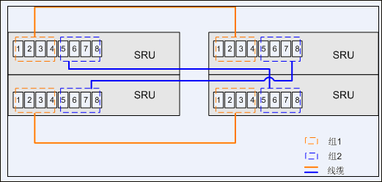
SFU Cluster: Cables for CSS Cards – S77/S97
Chassis
LPU
Optical module
Software and license
Cluster cable
Installation auxiliaries
Others
The CSS card is installed on the SRUCs of S9712/S9706, and is optional (The cluster cables are not delivered with cluster cards, and need to be configured independently.)
The CSS cards need to be configured in pairs. When the cluster cards are configured (cluster cables are not delivered with cluster cards), the cluster can be set up through SFP+ cables, SFP+ optical modules, or AOC cables. The cluster connection scheme is as follows:
Cable: 16 high-speed SFP+ cables, 1m, 3m, and 10m
Fiber: used together with SFP+ optical modules
Cluster connection rule is shown in the following figure:
On a cluster card, ports 1-4 belong to group 1 and ports 5-8 belong to group 2. The connections between cluster cards must meet the following requirements:
Ports in group 1 on one card must connect to ports in group 1 on another card. This rule also applies to ports in group 2.
A port in group 1 on one card can connect to any port in group 1 on another card. This rule also applies to ports in group 2.
Ports in group 1 and group 2 on one card must connect to different cards.

Slide 49
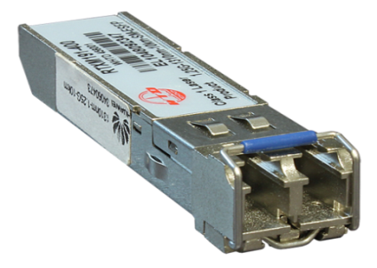
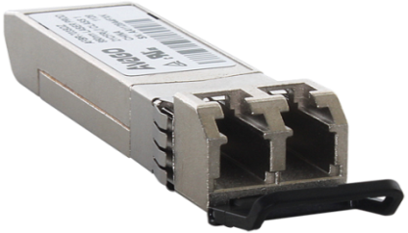
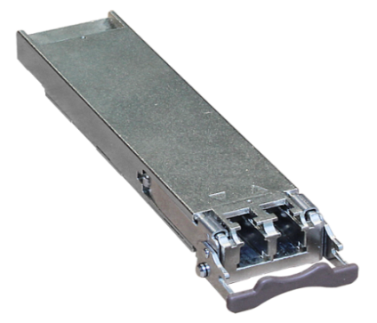
S9700 Configuration
Chassis
LPU
Optical module
Software and license
Installation auxiliaries
S7700
SFP+
SFP/eSFP
XFP
10GE
CWDM
DWDM
QSFP+

Slide 50
Optical Module Overview
Chassis
LPU
Optical module
Software and license
Cluster cable
Installation auxiliaries
Others
Type | Optical Module | Connector
SFP | FE | S9700 supports LC/PC Peer port (onsite survey required) LC/PC SC/PC FC/PC ST/PC If transmission distance is longer than 40km, XFP is recommended. Currently, SFP+ standard is not mature for the distance longer than 40km.
eSFP | FE
 | FE BIDI
 | GE
 | GE BIDI
 | POS
 | GE CWDM (not supported)
 | GE DWDM (not supported)
 | GE Electrical port module FE
SFP+ | 10GE
XFP | 10GE
 | 10GE CWDM
 | 10GE DWDM
QSFP+ | 40GE | MPO <150m multi-mode LC < 10Km single-mode
Precautions
The optical modules on two ends must have three identical parameters:
  Transmission distance
  Mode: single or dual
  Center wavelength
Interpretability: SFP+ ←→ XFP
BIDI: wavelengths on two ends match
TX1490/ RX1310 ←→ TX1310/ RX1490
CWDM optical module
Connects switches to WDM
Supports all 10G XFP LPUs, but does not support SFP+ LPU
*BIDI –single-core bidirectional
Fiber configuration

Slide 51
Optical Module Special Configuration
Chassis
LPU
Optical module
Software and license
Cluster cable
Installation auxiliaries
Others
Optical Module |  |  | LPU
02310CNF | OSX040N01 | SFP+, 10G, Single-mode Module (1550nm, 40km, LC) | 12x10GE 8x10GE
02310JFE | LE2MXSC80FF0 | SFP+, 10G, Single-mode Module (1550nm, 80km, LC) | 8x10GE
02310CRM | OSXD22N00 | SFP+, 10G, Multi-mode Module (1310nm, 0.22km, LC, LRM) | 40x10GE 16x10GE
Precautions
LRM optical module
Replacing old devices: OM1/2 fibers need to be deployed, and the old fibers are also required.
The new fibers are OM3 fibers.
Only 16*10G and 40*10G are supported.
OM3 fibers can be used together with OM1 and OM2 fibers.

Slide 52
S9700 Configuration
Chassis
LPU
Optical module
Software and license
Installation auxiliaries
S7700
S9703
S9706
S9712

Slide 53
Software and License
Chassis
LPU
Optical module
Software and license
Cluster cable
Installation auxiliaries
Others
Item | Configuration
Software fee-S9700 basic software, V200R001 | Select a software package according to customer needs. By default, the mainstream software package in the supply chain is delivered.
Software fee-S9700 basic software, V200R002
Software fee-S9700 basic software, V200R003
S9700 basic software, V200R005
MPLS
NQA
IPV6
X-series LPU FIB Resource License-128K | Used together with X1E cards, and installed on MPUs. Customers can purchase multiple licenses. The number of resources used by all X1E cards cannot exceed the total number of resources supported by all purchased licenses.
X-series LPU FIB Resource License-512K
WLAN Access Controller AP Resource License-512AP (with the X-series LPU used) | Used together with X1E cards, and installed on MPUs. Customers can purchase multiple licenses. The number of resources used by all X1E cards cannot exceed the total number of resources supported by all purchased licenses.
WLAN Access Controller AP Resource License-128AP (with the X-series LPU used)
WLAN Access Controller AP Resource License-64AP (with the X-series LPU used)
WLAN Access Controller AP Resource License-16AP (with the X-series LPU used)
ACU2 Wireless Access Controller AP Resource License(128 AP) | Used together with ACU2 cards, and installed on ACU2. Customers can purchase multiple licenses. The number of resources used by all ACU2 cards cannot exceed the total number of resources supported by all purchased licenses. This AP license is used separately with the AP license of X1E card. ACU2 cannot use the AP license of X1E card, and the X1E card cannot use the AP license of ACU2.

Slide 54
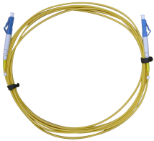
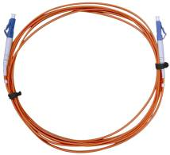
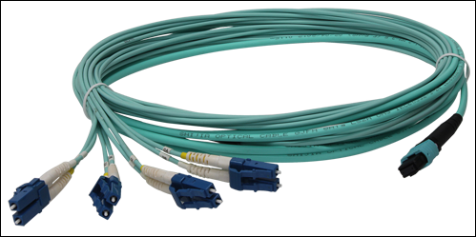
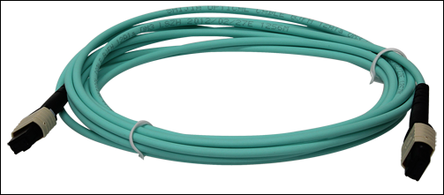
S9700 Configuration
Chassis
LPU
Optical module
Software and license
Installation auxiliaries
S7700
Single mode (Orange)
Multi-mode (Green)
QSFP+ && 4 SFP + Fiber
QSFP + && QSFP + Fiber

Slide 55

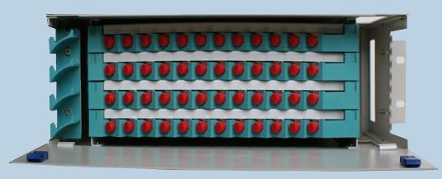
Fiber
Chassis
LPU
Optical module
Software and license
Cluster cable
Installation auxiliaries
Others
S9700
Peer device
ODF
Connector: LC/PC ←→ XX / PC
Onsite survey

Slide 56





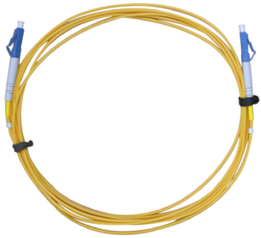


Jumper
Chassis
LPU
Optical module
Software and license
Cluster cable
Installation auxiliaries
Others
Connector | Fiber Connector
Square | SC/PC | LC/PC | MTRJ/PC | MPO
Circle | FC/PC | ST/PC
LC/PC - LC/PC
Jumper
Precautions
  One end connects to the S9700 and the other end connects to ODF or peer device.
  S9700 uses LC/PC. The peer port type is determined after onsite survey.
LC/PC pigtail
Notes:
S9303 delivers 2*10G line speed per slot.
S9306 delivers 12*10GE line speed per slot.
S9312 delivers 12*10GE line speed only on the two slots close to the MPU.

Slide 57
S9700 Configuration
Chassis
LPU
Optical module
Software and license
Installation auxiliaries
S7700 (The configuration principle of S7700 is the same as that of S9700. Only the differences are listed here.)

Slide 58
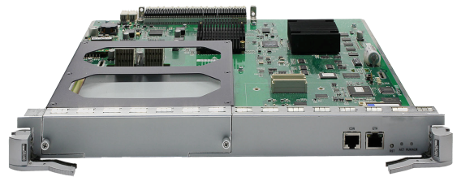
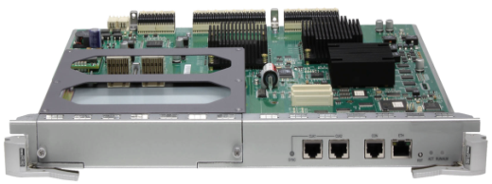

MPU – SRUA SRUB MCUA
Chassis
LPU
Optical module
Software and license
Cluster cable
Installation auxiliaries
Others
S7706/S7712-SRUA/SRUB
S7703-MCUA
Clock synchronization port (2)
SRUB
Ethernet port
Ethernet port
SRUA
Console port
Ethernet port
Console port
RS485
MON
Console port
512 Gbps switching capacity
Max power consumption 81 W
  Integrated SFU
1 Tbps switching capacity
Max power consumption 105 W
  Integrated SFU
Integrated monitoring unit
Max power consumption 18 W
No FSUA or VSTSA
No SFU
SRU tips
Functions of SRUA SRUB MCUA:
  Processes protocols and controls forwarding.
  Monitors component status.
  Performs management and maintenance according to user instructions.
FSUA: supports hardware OAM/BFD
CSS (VSTSA) subcard: supports SFU cluster
FSUA and VSTSA use the same SRU slot, so they cannot be installed in the same chassis.
  MPUs in 1+1 mode are recommended.
  The chassis contains a clock subcard (installed on MPU)

Slide 59





CSS & FSU
CSS unit
High cluster bandwidth
Non-block forwarding
High reliability
SRU
+
CSS
FSU
Ethernet OAM, MPLS OAM, BFD
CPU anti-DoS
Network Quality Analysis (NQA)
SRU
+
FSU

Slide 60


PoE Card -- Powering PDs
Chassis
LPU
Optical module
Software and license
Cluster cable
Installation auxiliaries
Others
PoE card
Scenario
Provides forty-eight GE electrical ports for data access and line-speed switching.
Provides data signals and DC power for the directly connected devices such as IP phones, APs, and network cameras.
Item | Specification
Powering capacity on one port | A maximum of 30 W The maximum power can be provided for 293 ports.
Standards compliance | 802.3af and 802.3at
MAC | 32K
IP | IPv4:32K, IPv6:16K
ARP | 16K
ACL | Inbound: 6000
MPLS VPN | MPLS L2 VPN, MPLS L3 VPN

Slide 61


PoE and Powering Mode
Chassis
LPU
Optical module
Software and license
Cluster cable
Installation auxiliaries
Others
800W AC
2200W AC
Tips
Operating voltage:
90V-290V
Output:
400W @110V
800W @220V
Operating voltage:
90V-290V
Output:
1100W @110V
2200W @220V
POE function must: POE power + POE LPU
System power and PoE power need to be configured at the same time.
* Huawei unprecedentedly separates system power and PoE power, facilitating maintenance and lowering CAPEX.
Note: 2200W AC and 800W AC cannot be installed in the same chassis.
Chassis | PoE AC Power Supply (220 V) | Backup | Max Power
S7703 | 2200 W | No | 2200 W
 | 800 W | No | 800 W
S7706 | 2200 W | 1+1, 2+2, 3+1, 4+0 | 8800 W
 | 800 W | 1+1, 2+2, 3+1, 4+0 | 3200 W
S7712 | 2200 W | 1+1, 2+2, 3+1, 4+0 | 8800 W
 | 800 W | 1+1, 2+2, 3+1, 4+0 | 3200 W
Notes:
Power supplies of different types cannot be installed in the same chassis. For example, a 2200 W AC power supply cannot be used together with an 800 W AC power supply.
Only AC power supply can be installed in the PoE slot.
Only AC power supply can be used as system power when S7703 is used as a PoE device.
When an AC power supply is installed in a PoE slot, it provides PoE power. When it is installed in PWR1 or PWR3, it provides system power.
The separation of system power and PoE power has the following advantages:
Easy to maintain: either of them can be replaced without affecting service
Low investment: only the system power can be purchased if PoE is not required

Slide 62
Contents
1.
Campus Switch SX7 Series Family
2.
Chassis Switch Configuration Guide
3.
Box Switch Configuration Guide

Slide 63
Box Switch: S5700
S5700 Chassis
LPU
Stack
Power Supply
Auxiliaries

Slide 64
S5700 Configuration Overview
Overview
S5700
Cards
Stack
Power
Auxiliaries
Product model
Fiber
Subcard
(includes stack card)
Power supply
LI SI EI HI
Auxiliaries
Optical module
Precautions
Model
  Series
  Whether PWR is supported
  Whether stack is supported
  Port types
Some models have built-in power supplies. You need to configure power supplies for the models without built-in power supplies.
Some models support subcards, and some do not.
The configuration principles of the following components are the same as those of S9700:
  Optical module
  Jumper
  Cable

Slide 65
S5700 Orientation
Overview
S5700
Cards
Stack
Power
Auxiliaries
QoS:
RR, DRR, PQ, WRR+PQ, DRR+PQ
Security:
IPSG, DAI, DCHP snooping
Reliability:
G.8032, SEP, LACP
O&M
Automatic configuration and upgrade
5720-HI
Box agile switch
SDN, integrated AC capability, iPCA, unified user management, 1.5 GB buffer, 1 MB FIB
HI
Advanced GE switch
MPLS, NetStream, hardware Ethernet OAM/BFD
EI
Enhanced GE switch
OSPF, BGP, 32K MAC, PIM, MPLS, NetStream
SI
Standard GE switch
RIP, RIPng, 16K MAC
LI
Simplified GE switch

Slide 66
S5700 Chassis
Product | MAC | VLANIF | ARP | IP | Routing Protocol | MPLS | Stack | NMS
5720-HI | 128M | 1024 | 128K | 1M | RIP/OSPF/BGP/ISIS and RIPv6/OSPFv6/BGPv6/ISISv6 | Yes | Roadmap | SNMP/WEB/CLI/TELNET
S5710HI | 456K | 1024 | 60K | 16K | RIP/OSPF/BGP/ISIS and RIPv6/OSPFv6/BGPv6/ISISv6 | Yes | Roadmap | SNMP/WEB/CLI/TELNET
5700HI | 32K | 1024 | 16K | IPv4: 12K IPv6: 6K | RIP/OSPF/BGP/ISIS and RIPv6/OSPFv6/BGPv6/ISISv6 | Yes | Supported by V2R3; long-distance stack; a maximum of 80 Gbps bidirectional bandwidth | SNMP/WEB/CLI/TELNET
5710-EI | 32K | 256 | 16K | IPv4: 16K IPv6: 8K | RIP/OSPF/BGP/ISIS and RIPv6/OSPFv6/BGPv6/ISISv6 | Yes | Long-distance stack; a maximum of 160 Gbps bidirectional bandwidth | SNMP/WEB/CLI/TELNET
5700-EI | 32K | 256 | 8K | IPv4: 16K IPv6: 8K | RIP/OSPF/BGP/ISIS and RIPv6/OSPFv6/BGPv6/ISISv6 | No | 1m/3m distance; a maximum of 48 Gbps bidirectional bandwidth | SNMP/WEB/CLI/TELNET
5700-SI | 16K | 256 | 8K | IPv4: 4K IPv6: 2K | IPv4: RIP IPv6: RIPng | No | 1m/3m distance; a maximum of 48 Gbps bidirectional bandwidth | SNMP/WEB/CLI/TELNET
5700-LI | 16K | 1 | 256 | IPv4: 16 IPv6: 16 | Static route | No | 20Gbps/40Gbps bidirectional bandwidth, depending on stack cables (not supported by some models) | SNMP/WEB/CLI/TELNET

Slide 67
S5700 Chassis
Product | Model | MAC | Stack | Sleep Mode | Power Redundancy | Depth | Management Port
S5700S-LI series | S5700S-28P-LI-AC S5700S-52P-LI-AC | 8K | N | Y | RPS | 220mm | RJ45 interface, USB console (mini USB)
S5700-P-LI common | S5700-10P-LI-AC S5700-28P-LI-AC S5700-28P-LI-DC S5700-52P-LI-AC S5700-52P-LI-DC S5700-10P-PWR-LI-AC S5700-28P-PWR-LI-AC S5700-52P-PWR-LI-AC | 16k | Y (except 10P mode) | Y (except PoE models) | RPS | S5700-10P-LI-AC: 180mm S5700-28P-LI-AC: 220mm S5700-28P-LI-DC: 220mm S5700-52P-LI-AC: 310mm S5700-52P-LI-DC: 310mm S5700-10P-PWR-LI-AC: 220mm S5700-28P-PWR-LI-AC: 310mm S5700-52P-PWR-LI-AC: 310mm | RJ45 interface, USB console (mini USB)
S5700-X-LI common | S5700-28X-LI-AC S5700-28X-LI-DC S5700-52X-LI-AC S5700-52X-LI-DC S5700-28X-LI-24S-AC S5700-28X-LI-24S-DC S5700-28X-PWR-LI-AC S5700-52X-PWR-LI-AC | 16K | Y | Y (except PoE models and models providing optical ports) | RPS | S5700-28X-LI-AC: 220mm S5700-28X-LI-DC: 220mm S5700-52X-LI-AC: 310mm S5700-52X-LI-DC: 310mm S5700-28X-LI-24S-AC: 220mm S5700-28X-LI-24S-DC: 220mm S5700-28X-PWR-LI-AC: 310mm S5700-52X-PWR-LI-AC: 310mm | RJ45 interface, USB console (mini USB)
Battery switch | S5700-28P-LI-BAT S5700-28P-LI-4AH S5700-28P-LI-24S-BAT S5700-28P-LI-24S-4AH | 16K | N | N | Battery | 310mm | RJ45 interface
Power-prepositive switches | S5701-28X-LI-AC S5701-28X-LI-24S-AC | 16K | Y | Y (except the models providing optical ports) | RPS | 220mm | RJ45 interface, USB console (mini USB)
CSFP switch | S5700-52X-LI-48CS-AC | 16K | Y | N | RPS | 220mm | RJ45 interface, USB console (mini USB)

Slide 68







Overview
S5700
Cards
Stack
Power
Auxiliaries
S5700 Service Card
ES5D000X4S00
ES5D000X2S00
ES5D000G4S00
ES5D00G4SA00
4*10GE SFP+ 2*10GE SFP+
  Applied to S5700SI; adaptive to GE optical/electrical modules
  Applied to S5700EI; not adaptive to GE
For 5700 EI/SI/LI
For 5700 EI/SI/LI
For EI
For LI/SI
4*10GE SFP+
2*10GE SFP+
4*GE SFP
Only applied to 5710-EI
10GE SFP+ subcard, adaptive to GE optical/electrical modules
2*10GE SFP+
8*GE SFP
8*GE Base-T
Notes:
4*GE interface cards of EI/SI cannot be configured in the same chassis.

Slide 69




Overview
S5700
Cards
Stack
Power
Auxiliaries
S5700 Service Card
Only applied to 5700-HI
10GE SFP+ sub-card, adaptive to GE optical/electrical modules
16*GE SFP
16*GE Base-T
4*10GE SFP+
4*40GE QSFP+
Only applied to 5710-HI
10GE SFP+ sub-card, adaptive to GE optical/electrical modules
4*10GE SFP+
2*10GE SFP+
4*GE SFP
Only applied to 5720-HI
Adaptive to GE optical/electrical modules
4*10GE SFP+
Notes:
4*GE interface cards of EI/SI cannot be configured in the same chassis.

Slide 70





S5700 Stack Overview
Overview
S5700
Cards
Stack
Power
Auxiliaries
Stack Card Stack
Stack Mode | Stack Card Stack | Service Port Stack
Models | S5700-SI S5700-EI S5710-LI | S5700-LI S5710-EI S5700-HI
Stacks | 9 | 9
Stack distance | 1m (LI/ SI /EI) 3m (EI) * Stack cable is delivered with stack card. | 5710-EI&S5700-HI supports long-distance (<=80 km) stack using fibers. 5700X-LI&5710-EI support 1m, 3m, and 10m stacks using SFP+ cables. 5700P-LI supports 1m and 10m stacks using SFP+ cables
Stack bandwidth | Two stack ports 48 Gbps bidirectional bandwidth | S5700-LI: 20 Gbps (1m cable)/40 Gbps (10m cable) bidirectional S5710-EI: 160 Gbps bidirectional S5700-HI: 80 Gbps bidirectional
Structure | Chain or ring | Chain or ring
Dual-active detection | Supported | Supported
Redundancy | 1:N | 1:N
Configuration management | A logical device: unified configuration (CLI), IP address, SNMP and system log
After stack setup | Unified routing table and MAC address table
Service Port Stack
Configuration tips: (1) A stack is set up using either service ports or stack cards. (2) Different models cannot set up a stack (for example, SI and EI cannot set up a stack). (3) 5700-X-LI and 5700-P-LI cannot set up a stack. (4) The stack consisting of S5710-HI and S5720-HI will be supported in later versions.
Notes:
S5700-10P-LI/S5700-10P-PWR-LI/S5700-26X-SI-12S-AC does not support iStack.

Slide 71
Stack Card List
Overview
S5700
Cards
Stack
Power
Auxiliaries
Product | Stack Mode | Description | Remarks
S5700-SI | Stack card | Ethernet stack interface card (delivered with 100cm cable) | A maximum of nine S5700 switches can be added to a stack. The switches are stacked through stack cards or service ports. The stack card can be installed in only the rear slot. To set up a stack through service ports, select SFP+ optical modules and matching fibers, or stack cables of different lengths. Note: If stack cards are used, only the 2*10GE card can be installed in the front slot. S5700SI and S5700EI support 3m stack cables. S5700LI, S5710EI, and S5700HI can set up long-distance stack using SFP+ optical modules.
 |  | Ethernet stack interface card (delivered with 300cm cable)
S5700-EI | Stack card | Ethernet stack interface card (delivered with 100cm cable)
 |  | Ethernet stack interface card (delivered with 300cm cable)
S5700-LI | Service port | SFP+ stack cable (100cm, two stack modules)
 |  | SFP+ stack cable (300cm, two stack modules)
 |  | SFP+ active high-speed cable (1000cm, two stack modules)
 |  | 3m AOC stack fiber
 |  | 10m AOC stack fiber
S5710-EI | Service port | SFP+ stack cable (100cm, two stack modules)
 |  | SFP+ stack cable (300cm, two stack modules)
 |  | SFP+ active high-speed cable (1000cm, two stack modules)
 |  | 3m AOC stack fiber
 |  | 10m AOC stack fiber
S5700-HI | Service port | SFP+ stack cable (100cm, two stack modules)
 |  | SFP+ stack cable (300cm, two stack modules)
 |  | SFP+ active high-speed cable (1000cm, two stack modules)
 |  | 3m AOC stack fiber
 |  | 10m AOC stack fiber

Slide 72



Overview
S5700
Cards
Stack
Power
Auxiliaries
Power Configuration Overview
Plan 1: Dual power supplies on non-PoE model
Plan 2: Dual power supplies on PoE model
Plan 3: Built-in power and external RPS
Hot swapping
A maximum of 30 W power on each port
A single built-in power supply provides 370 W PoE power
740 W PoE power provided after external RPS is used
A maximum of 740 W PoE power provided after backup power supply is used
Note: Share mode is not supported. That is, 740 W + 370 W = 1110W PoE power is not supported.
Applied to PoE models of S5700-LI
Hot swapping
A maximum of 30 W power on each port
250 W and 500 W PoE power supplies
1+1 backup or share mode
A maximum of 740 W PoE power provided
Applied to all models except the PoE models of S5700-LI
Hot swapping
AC or DC power supply
AC and DC power supplies cannot be installed on the same S5700-C.
AC and DC power supplies can be installed on the same S5710-E.

Slide 73




RPS1800: External Redundant Power of S5700(P/X/S)-LI
Overview
S5700
Cards
Stack
Power
Auxiliaries
Non-PoE
PoE
800 W power module
External PoE:
  Support 2 PoE devices
  740 W PoE power provided for each device
  Each RPS device requires a 800 W power supply
RPS and the built-in 370 W PoE power supply back up each other:
  740 W PoE power provided by each device
  Two 800 W power supplies required to provide PoE power for another device.
Support a maximum of 5 devices
Seamless power system switching when the built-in power supply is faulty
Notes:
800W (POE) + 800W (POE) + 150W (system)
1. Only one RPS (150 W) can be configured for a non-PoE device. Port 1 has the highest priority, and other ports have the same priority.

Slide 74
Box Switch Power Configuration Guide
Various power supplies are available for box switches. Configure power according to the following document:

Slide 75
Overview
S5700
Cards
Stack
Power
Auxiliaries
Auxiliaries- S2700&3700&5700
Component | Parameter | Product | Remarks
Port protection unit |  | S27&37&57 | (1) Need to be configured if power surge protection is required (2) One module for each RJ45 interface (3) Must be grounded
Power surge protection module |  | S27&37&57 | (1) Need to be configured if power surge protection is required (2) Only applied to AC power supply (3) One for each AC power supply (4) Must be grounded
USB flash drive | 1 GB / USB2.0 | S27&37&57 | Shared by multiple devices
SFP stack card | 150cm, including two stack modules | S3700 | (1) One card for each device (2) S3700s cannot set up stacks with other models (3) S3700-EI cannot set up stacks with S3700-SI
Ethernet stack card | Includes 100cm and 300cm stack cables | S5700 | (1) One card for each device (2) Cannot be installed on the same chassis with 4xGE or 4x10GE (3) S5700s cannot set up stacks with other models (4) S5700-EI cannot set up stacks with S5700-SI

