Slide 1
LS-DYNA Performance Benchmark and Profiling
October 2017

Slide 2
Note
The following research was performed under the HPC Advisory Council activities
Participating vendors: LSTC, Huawei, Mellanox
Compute resource - HPC Advisory Council Cluster Center
The following was done to provide best practices
LS-DYNA performance overview
Understanding LS-DYNA communication patterns
Ways to increase LS-DYNA productivity
MPI libraries comparisons
For more info please refer to
http://www.lstc.com
http://www.huawei.com
http://www.mellanox.com

Slide 3
LS-DYNA
LS-DYNA
A general purpose structural and fluid analysis simulation software package capable of simulating complex real world problems
Developed by the Livermore Software Technology Corporation (LSTC)
LS-DYNA used by
Automobile
Aerospace
Construction
Military
Manufacturing
Bioengineering

Slide 4
Objectives
The presented research was done to provide best practices
LS-DYNA performance benchmarking
MPI Library performance comparison
Interconnect performance comparison
Compilers comparison
Optimization tuning
The presented results will demonstrate
The scalability of the compute environment/application
Considerations for higher productivity and efficiency

Slide 5
Test Cluster Configuration
Huawei FusionServer E9000 with FusionServer CH121 V5 16-node (640-core) “Skylake” cluster
Dual-Socket 20-Core Intel Xeon Gold 6138 @ 2.00 GHz CPUs
Memory: 192GB memory, DDR4 2666 MHz RDIMMs per node
OS: RHEL 7.2, MLNX_OFED_LINUX-4.1-1.0.2.0 InfiniBand SW stack
Mellanox ConnectX-5 EDR 100Gb/s InfiniBand Adapters
Mellanox Switch-IB SB7800 36-port EDR 100Gb/s InfiniBand Switch
Compilers: Intel Parallel Studio XE 2018
MPI: Intel MPI 2018, Mellanox HPC-X MPI Toolkit v1.9.7, Platform MPI 9.1.4.3
Application: MPP LS-DYNA R9.1.0, build 113698, single precision
MPI Profiler: IPM (from Mellanox HPC-X)
Benchmarks: TopCrunch benchmarks
Neon Refined Revised (neon_refined_revised), Three Vehicle Collision (3cars), NCAC Minivan Model (Caravan2m-ver10), odb10m (NCAC Taurus model)

Slide 6
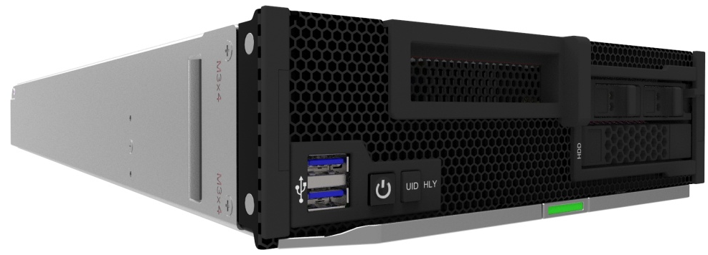

Introducing Huawei FusionServer E9000 (CH121) V5
High-Performance 2-Socket Blade Unlocks Supreme Computing Power
Full-series Intel® Xeon® Scalable Processors, 24 DDR4 DIMMs, AEP memory supported, 1 PCIe slot, 2 SFF/2 NVMe SSDs/4 M.2 SSDs high-performance storage, multi-plane network, LOM supported

Slide 7
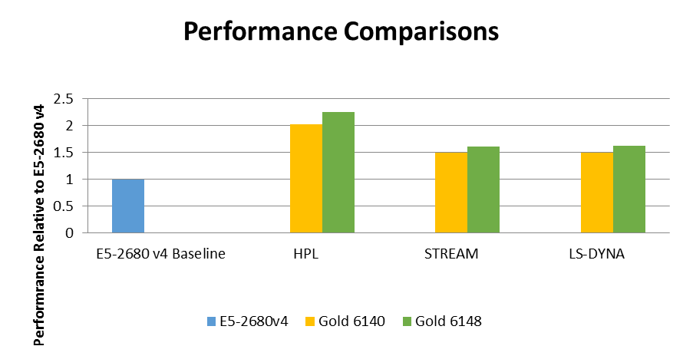
LS-DYNA Performance – CPU SKUs and Generation
LS-DYNA performance gain by larger core counts and better memory throughput
The “Gold 6140” demonstrates a 50% of performance gain (29% more cores) vs E5-2680v4
The “Gold 6148” demonstrates a 61% of performance gain (42% more cores) vs E5-2680v4
Base clock are the same on E5-2680 v4 and Gold 6148, while Gold 6140 runs slightly slower
Skylake supports 6 memory channels and faster DIMMs which impacts on memory performance
50%
61%
Higher is better
Single Node Performance
Notes:
7

Slide 8
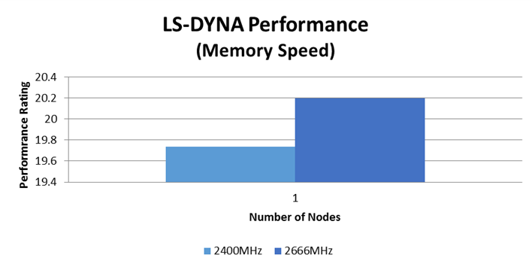
LS-DYNA Performance – Memory Speed
Memory speed provides some benefits to LS-DYNA performance
Skylake platform supports DIMM speed up to 2666MHz DIMMs
2666MHz DIMMs is theoretically ~11% faster than the 2400MHz DIMMs
LS-DYNA reports only about 2% of the improvement on a single node
It appears only part of the speed difference is translated into LS-DYNA performance gain
Higher is better
40 MPI Processes / Node
Notes:
8

Slide 9
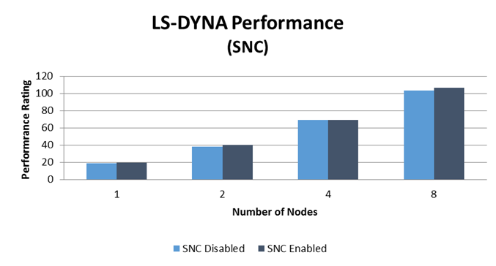
LS-DYNA Performance – Sub-NUMA Clustering
Enabling SNC provides some benefits for LS-DYNA
Sub-NUMA Clustering (SNC) is similar to a cluster-on-die (COD) in Haswell/Broadwell generation
CPU cores and memory would be split into 2 separate NUMA domains when SNC is enabled
SNC generally should demonstrate some benefits for applications that requires good NUMA locality
SNC demonstrates a performance gain of 3% on a single node basis
Higher is better
40 MPI Processes / Node
Notes:
9

Slide 10
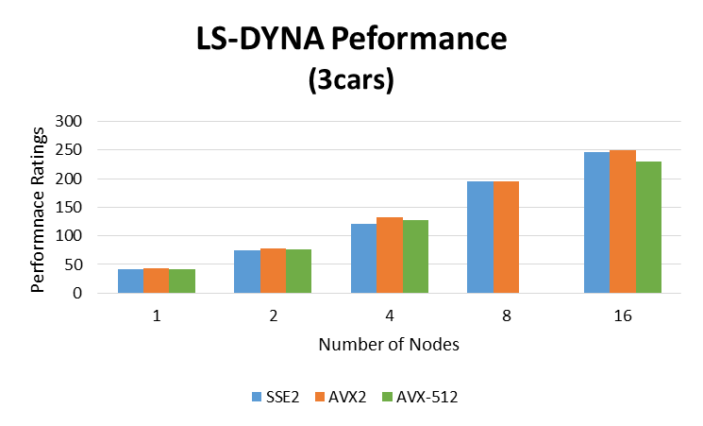
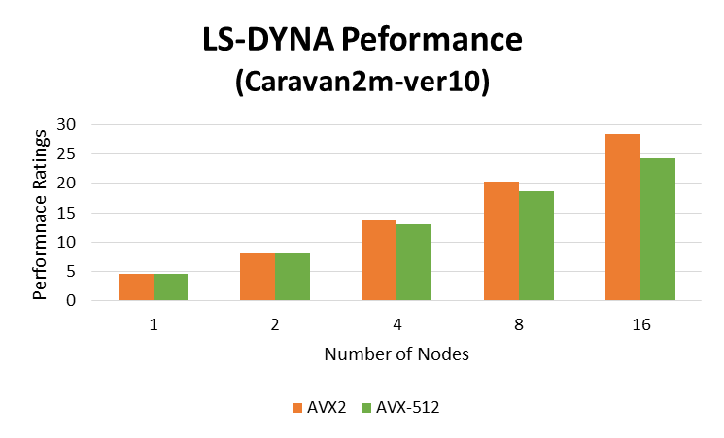
LS-DYNA Performance – CPU Instructions
AVX2 outperforms both AVX-512 and SSE2 executables on Skylake CPU
Performance gain of 17% by using AVX2 over AVX-512 executables
AVX-512 performs worse compared to AVX2, despite improved vectorization
AVX-512 instructions runs at a reduced clock frequency as AVX2 and normal clocks
Benefit of AVX2 appears to be larger on bigger dataset (such as car2car)
17%
8%
4%
3%
Higher is better
40 MPI Processes / Node
Notes:
10

Slide 11
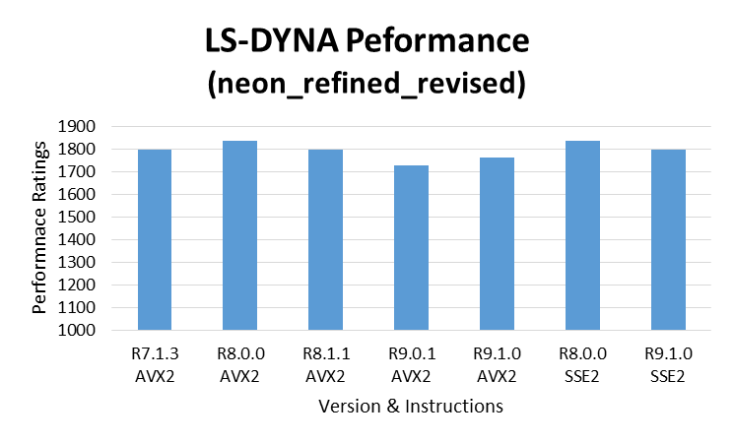
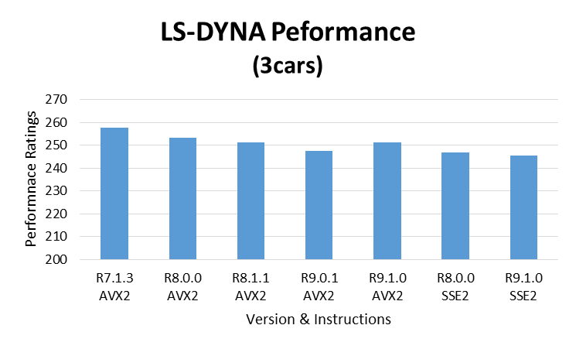
LS-DYNA Performance – CPU Instruction Sets
Some variance in performance among different LS-DYNA versions/executables
AVX2 performs better than SSE2 LS-DYNA executables
Small variance in performance among different LS-DYNA releases
R7.1.3 appeared to perform better on larger datasets
20%
Higher is better
40 MPI Processes / Node
Notes:
11

Slide 12
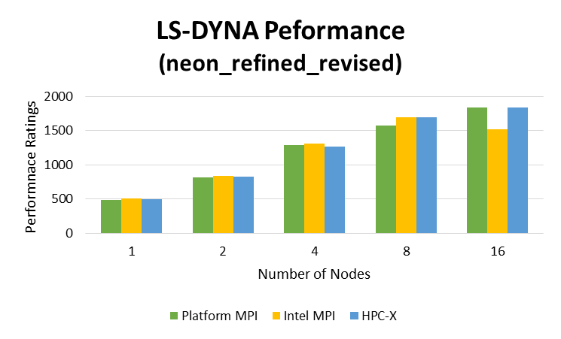
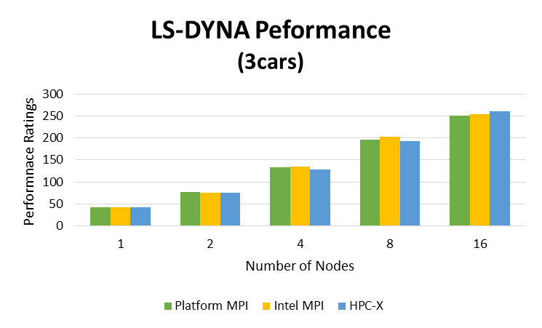
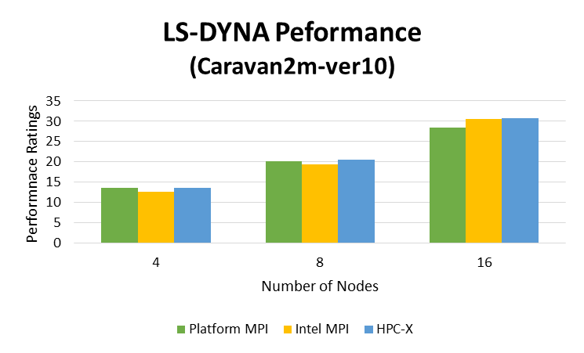
LS-DYNA Performance – MPI Libraries
All three MPI implementations shows decent performance at scale
Platform MPI and HPC-X performs similarly, while Intel MPI shows a drop at small dataset at scale
Higher is better
40 MPI Processes / Node
Notes:
12

Slide 13
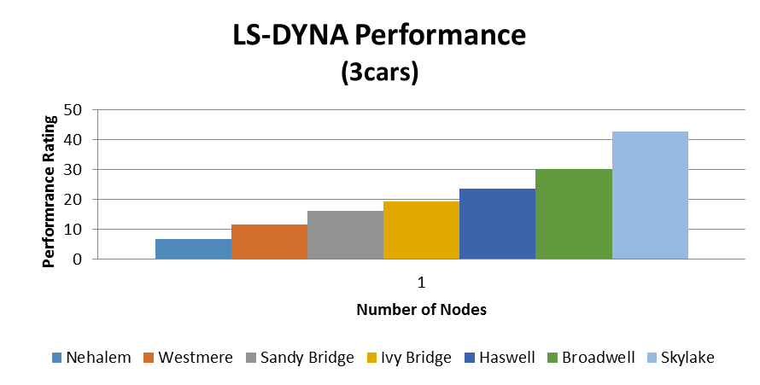
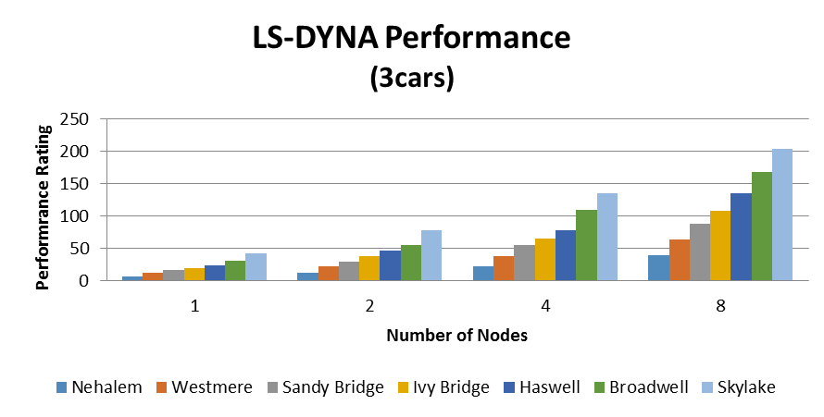
LS-DYNA Performance – System Generations
Current Skylake system configuration outperforms prior system generations
Skylake platform outperformed Broadwell by 21%, Haswell by 51%, Ivy Bridge by 89%, Sandy Bridge by 132%, Westmere by 222%, Nehalem by 425%
Skylake performs 41% better than Broadwell for the 3cars model on a single-node basis
System components used:
Skylake: 2-socket 20-core Xeon Gold 6138 2.0GHz, 2666MHz DIMMs, ConnectX-5 EDR InfiniBand
Broadwell: 2-socket 14-core Xeon E5-2690v4 2.6GHz, 2400MHz DIMMs, ConnectX-4 EDR InfiniBand
Haswell: 2-socket 14-core Xeon E5-2697v3 2.6GHz, 2133MHz DIMMs, ConnectX-4 EDR InfiniBand
Ivy Bridge: 2-socket 10-core Xeon E5-2680v2 2.8GHz, 1600MHz DIMMs, Connect-IB FDR InfiniBand
Sandy Bridge: 2-socket 8-core Xeon E5-2680 2.7GHz, 1600MHz DIMMs, ConnectX-3 FDR InfiniBand
Westmere: 2-socket 6-core Xeon x5670 2.93GHz, 1333MHz DIMMs, ConnectX-2 QDR InfiniBand
Nehalem: 2-socket 4-core Xeon x5570 2.93GHz, 1333MHz DIMMs, ConnectX-2 QDR InfiniBand
41%
Higher is better
Best results shown
Notes:
13

Slide 14
LS-DYNA Summary
LS-DYNA is multi-purpose explicit and implicit finite element program
Utilizes both compute and network communications
MPI library performance
Platform MPI and HPC-X performs similarly, while Intel MPI shows a drop at small dataset
Effect on CPU instructions
AVX-512 performs worse compared to AVX2, despite improved vectorization
AVX-512 instructions runs at a reduced clock frequency as AVX2 and normal clocks
Effect on CPU cores per node
Almost no difference when limiting the number of CPUs per node from 40 to 36 or 32
Effect on LS-DYNA versions
Small variance in performance among different LS-DYNA releases

Slide 15

Thank You
HPC Advisory Council
All trademarks are property of their respective owners. All information is provided “As-Is” without any kind of warranty. The HPC Advisory Council makes no representation to the accuracy and completeness of the information contained herein. HPC Advisory Council undertakes no duty and assumes no obligation to update or correct any information presented herein
15

