Slide 1
OpenFOAM
Performance Benchmark and Profiling
October 2017

Slide 2

Note
The following research was performed under the HPC Advisory Council activities
  Participating vendors: Huawei, Mellanox
  Compute resource - HPC Advisory Council Cluster Center
The following was done to provide best practices
  OpenFOAM performance overview
  Understanding OpenFOAM communication patterns
  Ways to increase OpenFOAM productivity
  MPI libraries comparisons
For more info please refer to
  http://www.huawei.com
  http://www.mellanox.com
  https://www.openfoam.com/

Slide 3
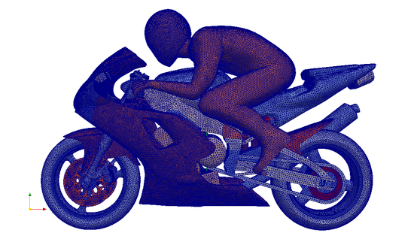

OpenFOAM
OpenFOAM® (Open Field Operation and Manipulation) CFD
Toolbox in an open source CFD applications that can simulate
  Complex fluid flows involving
  Chemical reactions
  Turbulence
  Heat transfer
  Solid dynamics
  Electromagnetics
  The pricing of financial options
OpenFOAM support can be obtained from OpenCFD Ltd

Slide 4
Objectives
The presented research was done to provide best practices
  OpenFOAM performance benchmarking
    MPI Library performance comparison
    Interconnect performance comparison
    Compilers comparison
    Optimization tuning
The presented results will demonstrate
  The scalability of the compute environment/application
  Considerations for higher productivity and efficiency

Slide 5
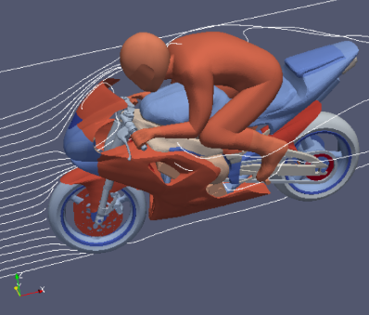
Test Cluster Configuration
Huawei FusionServer E9000 with FusionServer CH121 V5 16-node (640-core) “Skylake” cluster
  Dual-Socket 20-Core Intel Xeon Gold 6138 @ 2.00 GHz CPUs (27.5MB L3 Cache, Turbo @3.70 GHz)
  Dual-Socket 18-core Intel Xeon Gold 6140 @ 2.30 GHz CPUs (24.75MB L3 Cache, Turbo @3.70 GHz)
  Dual-Socket 20-core Intel Xeon Gold 6148 @ 2.40 GHz CPUs (27.5MB L3 Cache, Turbo @3.70 GHz)
  Memory: 192GB memory, DDR4 2666 MHz RDIMMs per node
  OS: RHEL 7.3, MLNX_OFED_LINUX-4.1-1.0.2.0 InfiniBand SW stack
Mellanox ConnectX-4 and ConnectX-5 EDR 100Gb/s InfiniBand Adapters
Mellanox Switch-IB SB7800 36-port EDR 100Gb/s InfiniBand Switch
Huawei OceanStor 9000 Scale-out NAS storage system
Compilers: Intel Parallel Studio XE 2018
MPI: Intel MPI 2018, Mellanox HPC-X MPI Toolkit v1.9.7
Application: OpenFOAM v1612+, single precision
Benchmarks: MotorBike, 160K elements, 100 steps

Slide 6
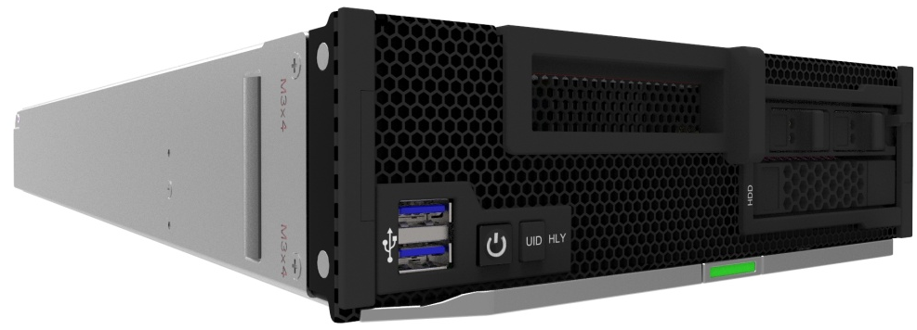

Introducing Huawei FusionServer E9000 – CH121 V5
High-Performance 2-Socket Blade Unlocks Supreme Computing Power
Full-series Intel® Xeon® Scalable Processors, 24 DDR4 DIMMs, AEP memory supported, 1 PCIe slot, 2 SFF/2 NVMe SSDs/4 M.2 SSDs high-performance storage, multi-plane network, LOM supported

Slide 7
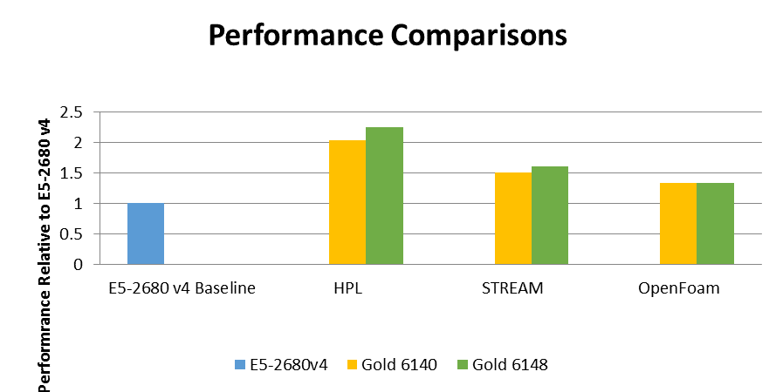
OpenFOAM Performance – CPU SKUs and Generation
OpenFOAM performance gain by larger core counts and better memory throughput
  “Gold 6140” demonstrates a 34% of performance gain (29% more cores) vs E5-2680v4
  “Gold 6148” demonstrates a 34% of performance gain (42% more cores) vs E5-2680v4
  Base clock are the same on E5-2680 v4 and Gold 6148, while Gold 6140 runs slightly slower
  Skylake supports 6 memory channels and faster DIMMs which impacts on memory performance
34%
34%
Higher is better
Single Node Performance
Notes:
7

Slide 8
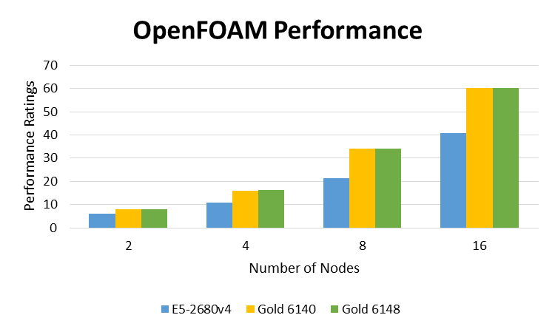
OpenFOAM Performance – CPU SKUs and Generation
Performance benefits of Skylake CPU grows as cluster scales (on per-node basis)
  Performance gain of ~60% by “Skylake” CPUs compared to “Broadwell” CPUs
    Difference may be mainly due to additional cores, and newer CPU architecture available in Skylake
  No difference in using “Gold 6140” versus “Gold 6148”, despite slightly higher clock and more cores
    Gold 6148 has 2 more CPU cores, and slight increase in CPU base clock
    Possible reason may be memory bandwidth saturation, and turbo clock are same for both CPUs
47%
60%
34%
46%
Higher is better
40 MPI Processes / Node
Notes:
8

Slide 9
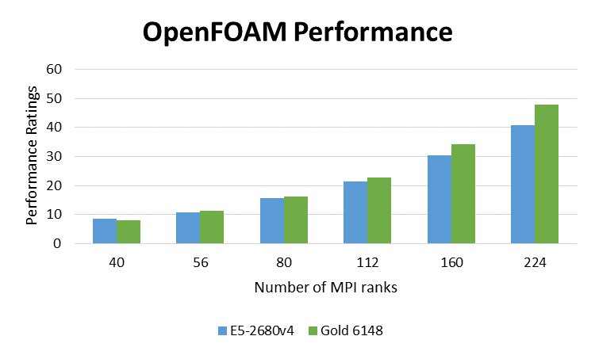
OpenFOAM Performance – CPU SKUs and Generation
Performance benefits of Skylake CPU grows as cluster scales (on by-core basis)
  Performance is even between “Skylake” CPUs and “Broadwell” CPUs at 40 cores
  Performance gain become much more apparent at scale
  CPU Information:
    Gold 6148: Dual Socket 20-core Intel Xeon 6148 @ 2.4GHz (Turbo @ 3.7GHz)
    E5-2680v4: Dual Socket 14-core Intel Xeon E5-2680v4 @2.4GHz (Turbo @ 3.3GHz)
17%
12%
6%
4%
2%
Higher is better
Notes:
9

Slide 10
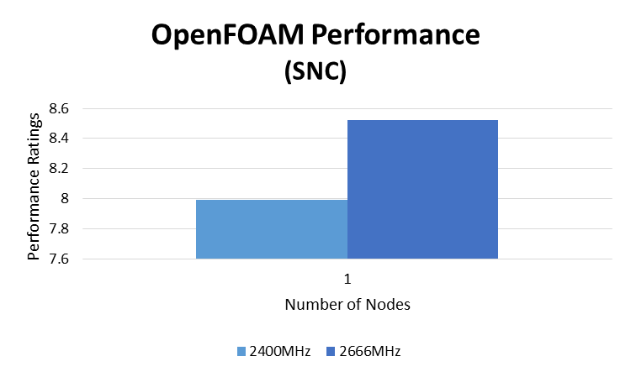
OpenFOAM Performance – Memory Speed
Memory speed provides some benefits to OpenFOAM performance
  Skylake platform supports DIMM speed up to 2666MHz DIMMs
  2666MHz DIMMs is theoretically ~11% faster than the 2400MHz DIMMs
  OpenFOAM reports only about ~5% of the improvement on a single node
  Only part of the benefits in speed is translated into performance gain for OpenFOAM
Higher is better
40 MPI Processes / Node
Notes:
10

Slide 11
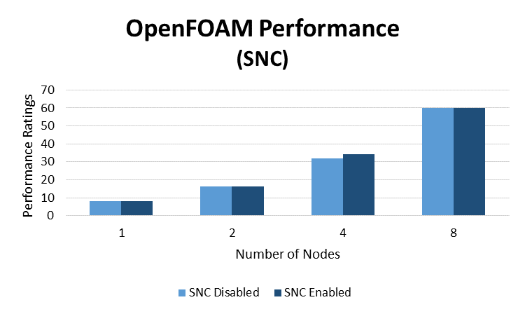
OpenFOAM Performance – Sub-NUMA Clustering
Enabling SNC provides marginal benefits for OpenFOAM
  Sub-NUMA Clustering (SNC) is similar to a cluster-on-die (COD) in Haswell/Broadwell generation
  CPU cores and memory would be split into 2 separate NUMA domains when SNC is enabled
  SNC generally should demonstrate some benefits for applications that requires good NUMA locality
  SNC only demonstrates small marginal gain when SNC is enabled
Higher is better
40 MPI Processes / Node
Notes:
11

Slide 12
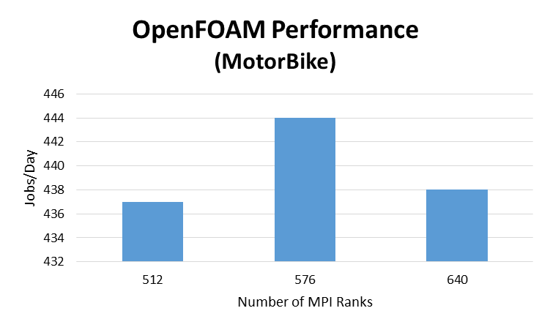
OpenFOAM Performance – Processes Per Node
Observed best performance with using less CPU cores per node
  Some benefits by using 36 cores per node on a Gold 6138; compared to 40 or 32 PPN
  Dual-socket “Gold 6138” provide up to 40 per node
  Potentially due to memory bandwidth saturation for the number of Skylake cores
Gold 6138

Slide 13
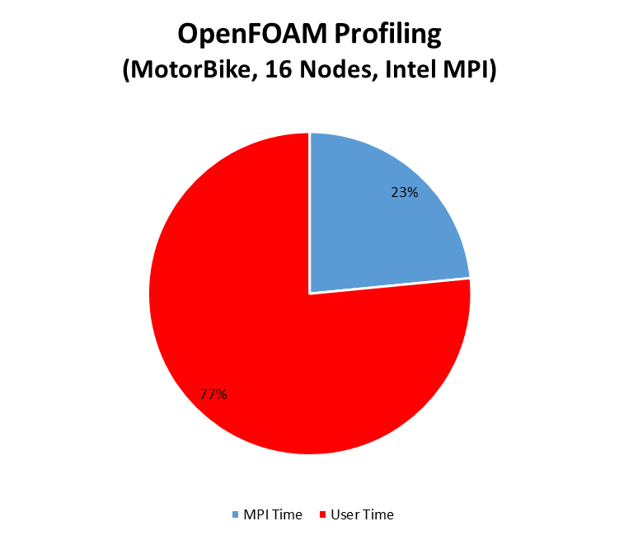

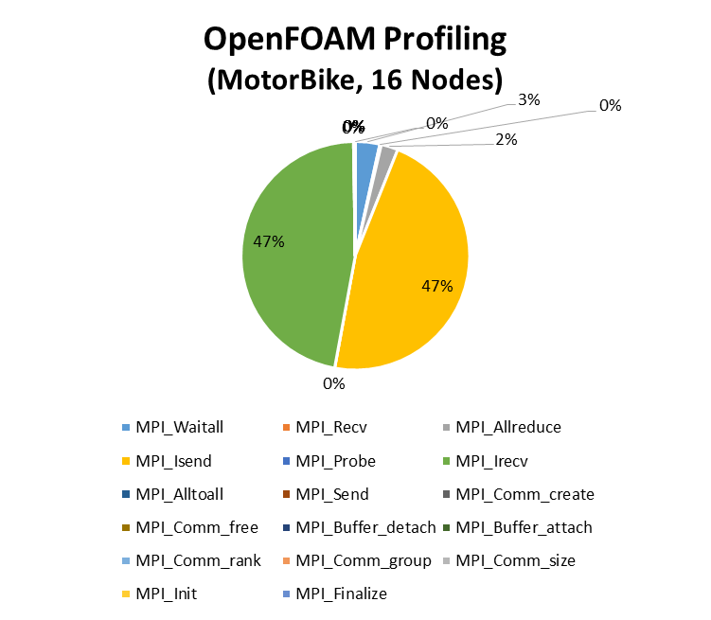

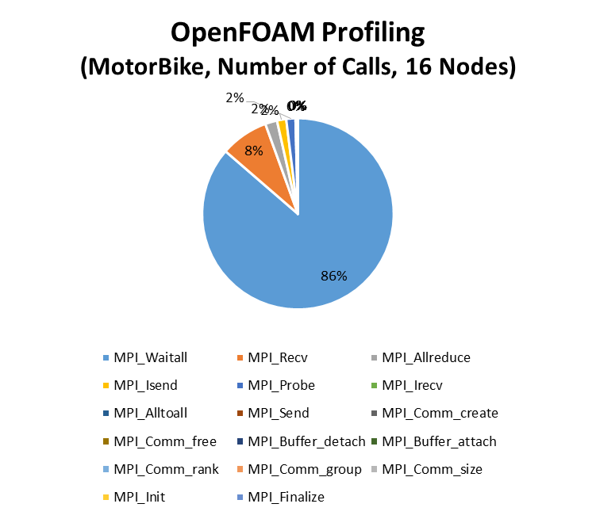
OpenFOAM Profiling – MPI/User Time Ratio
OpenFOAM simpleFOAM solver uses mainly non-blocking communications
  23% of overall runtime spent on MPI communication at 16 nodes / 640 MPI cores
  Both Intel MPI and HPC-X spent the same time in overall runtime on MPI communications
  Overall of MPI time spent in MPI non-blocking communications (MPI_Waitall 47%, MPI_Isend, 47%)
  Most of the MPI calls made by OpenFOAM are MPI_Waitall
Notes:
13

Slide 14
OpenFOAM Summary
OpenFOAM performance gain by larger core counts and better memory throughput
  “Gold 6140” demonstrates a 34% of performance gain (29% more cores) vs E5-2680v4 (on 1-node)
  “Gold 6148” demonstrates a 34% of performance gain (42% more cores) vs E5-2680v4 (on 1-node)
  Performance gain of ~60% by “Skylake” CPUs compared to “Broadwell” CPUs (on multi-node)
  No difference in using “Gold 6140” versus “Gold 6148”, despite slightly higher clock and more cores
Effect on MPI on OpenFOAM “simpleFOAM” solver performance
  Intel MPI (DAPL) performs slightly better for up to 16 nodes
Effect on Skylake generation on OpenFOAM performance
  Provides substantial performance gain due to the larger core count, support for memory channels
  Faster 2666MHz DIMM (compares to 2400MHz) translates to increase of 5% in performance
Effect on SNC (Sub-NUMA Clustering) on performance
  Enabling Sub-NUMA Clustering provides little/marginal benefits
Observed best performance is using less cores than available per node
  Slight benefits by using 36 CPU cores per node; compared to 40 or 32 PPN

Slide 15

Thank You
HPC Advisory Council
All trademarks are property of their respective owners. All information is provided “As-Is” without any kind of warranty. The HPC Advisory Council makes no representation to the accuracy and completeness of the information contained herein. HPC Advisory Council undertakes no duty and assumes no obligation to update or correct any information presented herein
15

