Slide 1
FusionServer X6800 High-Density Server Technical Presentation

Slide 2
Contents
1
Trends and Positioning
2
Introduction to the X6800
3
Application Scenarios and Cases

Slide 3
High-Density Server Market
Only 0.8% in 2009
Source: Gartner (2015Q2)
Source: IDC(2015Q2)
  High-density servers occupy 21% in shipments in worldwide.
Notes:
According to Gartner 2015 Q2 report, the market share of high-density servers has increased from 0.8% in 2009 to the 21% in 2015. The market has seen a rapid increase of demands for high-density servers.

Slide 4
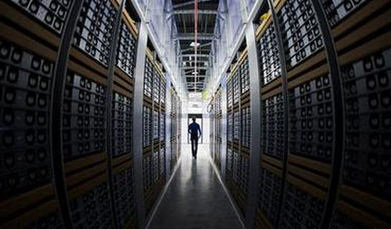

Increasing Data Center Servers With The Influence of Internet and Cloud Computing
Cloud computing, big data, distributed storage, HPC…
Notes:
Why did the market share of high-density servers increase so rapidly? In recent years, the number of servers in data centers has increased sharply thanks to the influence of applications, such as Internet, cloud computing, and big data. Certain companies, such as Internet-based businesses like Google, Amazon, Tencent, and Alibaba, have deployed tens or even hundreds of thousands of servers in their data centers.

Slide 5




Challenges for Large-Scale Deployments of Servers
Space
Insufficient deployment space
Time
Long deployment period
Power consumption
High power consumption
Management
Complex and inefficient management
Notes:
The large-scale application of servers also presents a number of issues and challenges to these enterprises in terms of floor space, deployment time, energy consumption, and management. Enterprises are facing floor space shortage due to the large-scale deployment of servers. They have to lease floor space, which increases costs. As for deployment time, it takes at least one month to unpack and deploy over ten thousands of conventional rack servers in equipment rooms, which postpones service rollout. As for energy consumption and management, hundreds of thousands of servers will cause an electricity charge of up to over one million US dollars per year, and their O&M is difficult. The emergence of high-density servers addressed these problems thanks to their features of high density and energy efficiency.

Slide 6

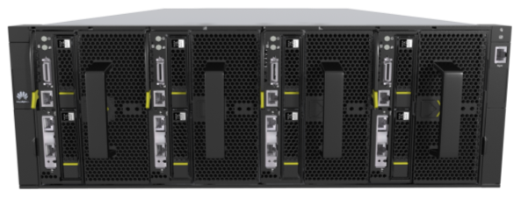
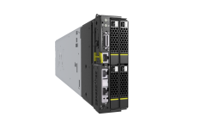
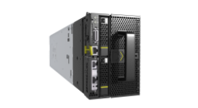
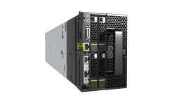
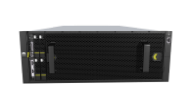
X6800 : One Architecture for Various Business
Web Cache
  X6800:
  Unified 4U architecture
  Multiple nodes for various services
  High density and energy saving
  Rapid deployment and efficient maintenance
HPC
Server SAN
Cloud
Big Data
Compute node
Storage node
HPC node
……

Slide 7
A variety of application scenarios with one system
HPC/Web Cache
Compute Node XH620 V3
Big Data (Hadoop)/Server SAN
Storage Node XH628 V3
X6800
Graphics acceleration/ Simulation
/ 3D rendering
GPU Node XH622 V3
Notes:
The X6800 server supports three types of server nodes, including high-density compute node XH620 V3, high-density storage node XH628 V3, and application acceleration node XH622 V3. The XH620 V3 is ideal for HPC and web cache scenarios. The XH628 V3 applies to scenarios, such as big data and distributed storage. The XH622 V3 is suitable for scenarios, such as graphical acceleration, simulation, and 3D rendering.

Slide 8
Contents
1
Trends and Positioning
2
Introduction to the X6800
3
Application Scenarios and Cases

Slide 9
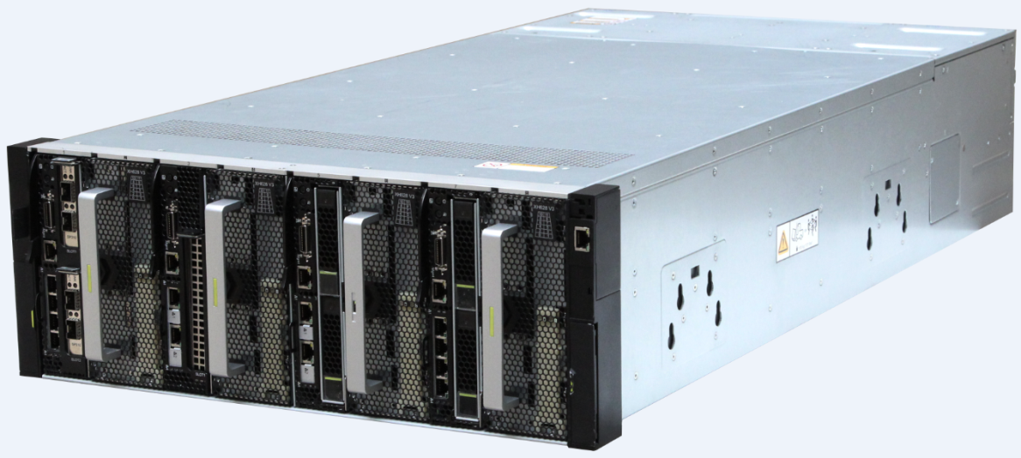
Side View of the X6800 Chassis
Front management network port
Slot 1
Slot 2
Slot 3
Slot 4
Slot 5
Slot 6
Slot 7
Slot 8
Heat dissipation hole
898 mm
175
mm
Server module
Provides eight slots.
Supports four dual-slot and eight single-slot server nodes
Will support two four-slot compute nodes, or one eight-slot compute node.
447 mm
Notes:
The X6800 chassis is 4 U high (1 U = 4.445 cm) and can be installed in a 19-inch standard cabinet. The X6800 chassis provides eight vertical slots at the front for installing 4 server nodes (each occupies two slots) or 8 server nodes (each occupies one slot). The server nodes available in the market will be introduced later. At the upper right corner of the chassis front panel, there is a converged management port. You can use this port to manage all server nodes in the chassis. The upfront part in the upper part of the chassis has a row of heat dissipation holes, which supply the system with cool air to improve heat dissipation efficiency. Detailed introduction will be provided in the heat dissipation optimization part later.

Slide 10
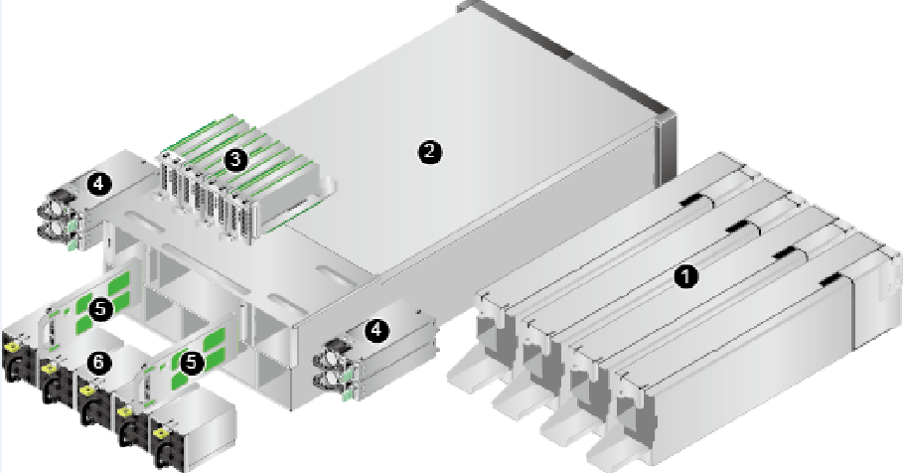
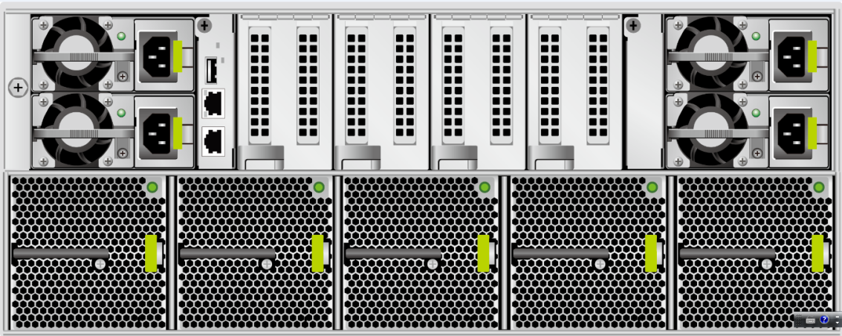
Rear View of the X6800 Chassis
management board
HMM
Eight rear half-height half-length
PCIe 3.0 x8 slots
Four redundant PSUs
750 W/1200 W/1500W AC platinum (94%)
or 800 W DC gold (92%)
Five counter-rotating fan modules supporting one-fan failures
N+1 redundancy and 4500W heat dissipation capability
Notes:
This is the rear of the chassis. At the lower part, there are five fan modules. They provide N+1 redundancy and deliver up to 4500 W heat dissipation capability. The upper part includes four PSUs, eight PCIe slots and one chassis management board. The PSUs support 1+1, 2+2, and 3+1 redundancy modes. You can choose from AC or DC PSUs of different power and voltage specifications based on actual requirements. Considering energy conservation, we provide platinum AC PSUs delivering up to 95% AC/DC power conversion efficiency. In the future, we will introduce platinum PSUs with higher power conversion efficiency. The figure on the left shows the overall structure of an X6800. We can see that the server nodes, PSUs, fan modules, and MM adopt the modular design, which allows quick and flexible deployment and maintenance.

Slide 11
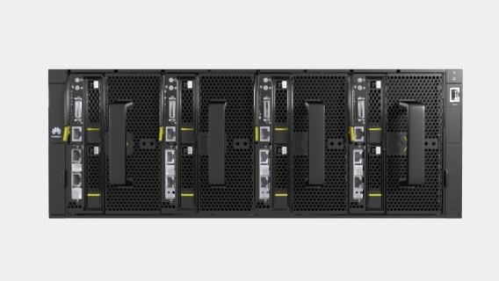
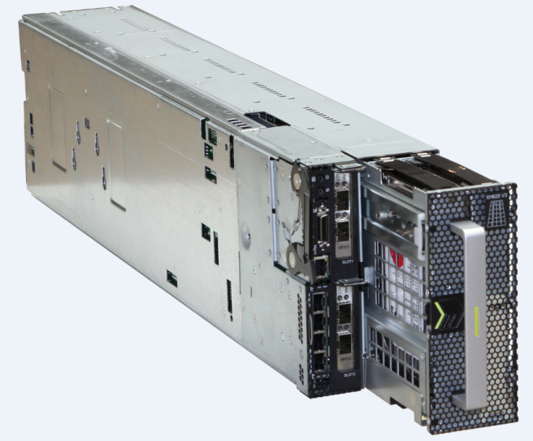
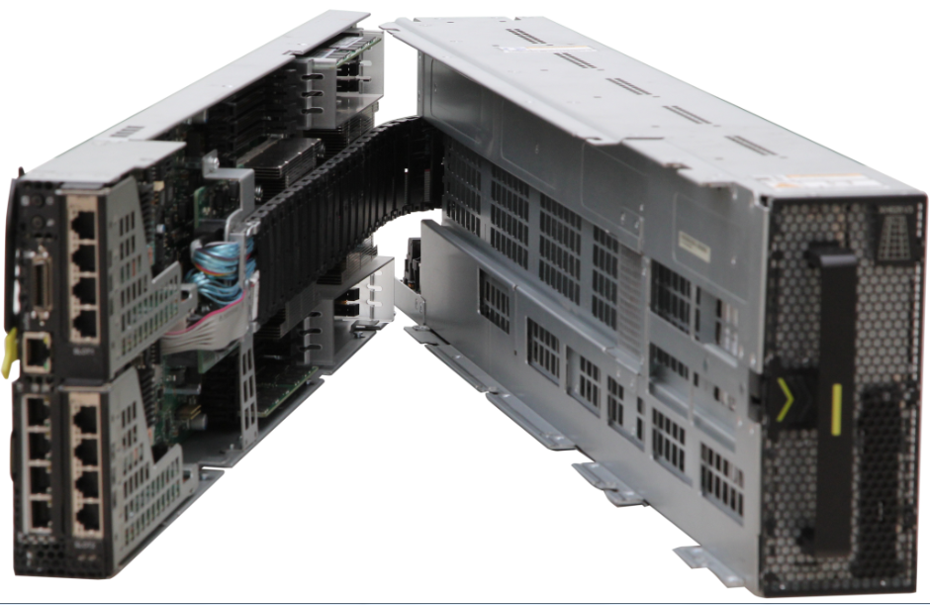
XH628 V3 2-Socket Storage Node
XH628 V3 appearance
Exterior of the XH628 V3
Form factor | Dual-slot 2-socket server node
Number of CPUs | One or two
CPU model | Intel Xeon E5-2600 v3/v4
DIMM slot | 16 DDR4 DIMM slots, supporting a maximum memory capacity of 1024 GB
Number of hard disks | 12*3.5" or 2.5" hot-swappable SAS/SATA disks or SSDs, with two 2.5" SATA disks/SSDs for option
LOM network port | (Optional) 2xGE、4xGE、2x10GE、2xGE+2x10GE、2x10GBase-T or 2x56G IB
RAID support | RAID 0, 1, 10, 5, 50, 6, and 60, supporting a supercapacitor
PCIe expansion capacity | Up to five PCIe expansion slots: two front half-height half-length PCIe 3.0 x8 slots, two rear half-height half-length PCIe 3.0 x8 slots, and one RAID controller card. The front PCIe slots and the two 2.5-inch disks cannot be configured at the same time.
Onboard storage medium | Two Mini SSDs(SATA DOMs) and one USB flash drive
Front port | One high-density port (one VGA port, three USB 2.0 port, and one serial port), and one GE management network port
Operating temperature | 5℃ to 40℃
Dimensions (H x W x D) | 109 mm x 745 mm x 166 mm
Node
Highlights
Space saved: A high-density 4U4 architecture reduces the reduce rack space by 50%.
Massive storage: Four XH628 V3 server nodes in the 4 U chassis provide a 400 TB storage capacity, suitable for the massive storage applications such as cloud computing and data centers.
Efficient operation: The XH628 V3 supports the E5-2600 v3 Intel CPUs, DDR4 DIMMs, and four HH HL Huawei ES3000 PCIe cards, meeting the requirements of high-performance storage applications.
Notes:
Now, let's look at the specifications of XH628 V3. Four XH628 V3 server nodes can be deployed in a 4 U X6800 chassis, with the density equivalent to four 2 U universal rack servers in an 8 U space, saving the cabinet space by 50%. The X6800 provides a maximum of 400 TB storage capacity when configured with four XH628 V3 server nodes per chassis, and also supports high-performance PCIe SSD storage acceleration cards, meeting the requirements for storage servers in the era of cloud computing and big data. In addition, the XH628 V3 server node uses the latest Intel® Xeon® E5 v3 processors and DDR4 DIMMs, providing excellent performance, quick system response, and high efficiency. Note the following points as for XH628 V3 specifications: Firstly, it supports only 16 DIMM slots, rather than 24 DIMM slots supported by the platform, due to limited space. In addition, 16 DIMM slots can meet the memory required by a storage server. Competitors' similar products also provide 16 DIMM slots. Secondly, it has two built-in STATDOMs that support RAID 1 and serve as a system installation disk, saving local storage space. Thirdly, the XH628 V3 can be installed with two front hard disks or PCIe cards. You can select either of them. Fourthly, XH628 V3 runs stably at 40℃, which is a rare feature in high-density servers. This means that the heat dissipation of the whole server is good. We will describe the heat dissipation capacity later.

Slide 12
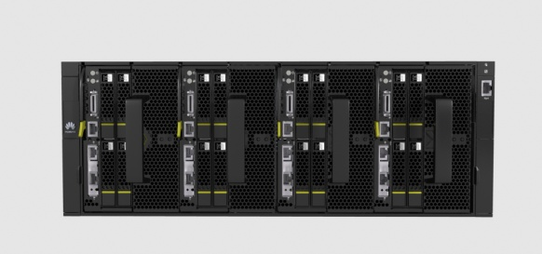

XH622 V3 2-Socket GPU Node
XH622 V3 appearance
Exterior of the XH622 V3
Form factor | Dual-slot 2-socket server node
Number of CPUs | One or two
CPU model | Intel Xeon E5-2600 v3/v4
DIMM slot | 16 DDR4 DIMM slots, supporting a maximum memory capacity of 1024 GB
Number of hard disks | Four 2.5-inch SAS/SATA disks or SSDs
LOM network port | (Optional) 2xGE、4xGE、2x10GE、2xGE+2x10GE、2x10GBase-T or 2x56G IB
RAID support | RAID 0, 1, 10, 5, 6, supporting a supercapacitor
PCIe expansion capacity | Up to five PCIe expansion slots: two built-in double-width, full-height, full-length PCIe 3.0 x16 slots, two rear half-height half-length PCIe 3.0 x8 slots, and one RAID controller card
Onboard storage medium | Two Mini SSDs(SATA DOMs) and one USB flash drive
Front port | One high-density port (one VGA port, three USB 2.0 port, and one serial port), and one GE management network port
Operating temperature | 5℃ to 40℃
Dimensions (H x W x D) | 109 mm x 670 mm x 166 mm
Node
Highlights
Space reduced: A high-density 4U4 architecture reduces the equipment footprint by 50%.
Superb performance: Four XH622 V3 server nodes are deployed in the 4 U chassis, supports eight high-performance GPGPUs or Xeon-Phi cards, providing a floating-point computing performance of 28 TFLOPS and meeting the HPC requirements of applications such as graphics acceleration, simulation, and 3D rendering.
Notes:
Now, let's look at the specifications of XH622 V3. An X6800 server can hold up to four XH622 V3 server nodes in a 4 U chassis, which offers the density equivalent to four 2 U rack servers in an 8 U space. That means the X6800 server requires 50% less floor space. XH622 V3 is an I/O expansion node, and uses the latest Intel® Xeon® E5 v3 processors and DDR4 DIMMs, providing the excellent computing performance. Also, it provides five PCIe slots. When used in HPC, the X6800 chassis can be configured with up to eight dual-width GPGPUs or Xeon-Phi cards to deliver a computing power of 28 TFLOPS. Note the following points as for XH622 V3 specifications: Firstly, it supports a maximum of 16 DIMM slots, so are competitors' similar products. Secondly, it has two built-in STATDOMs that support RAID 1 and serve as a system installation disk, saving local storage space. Thirdly, it supports two GPGPUs or Xeon-Phi cards, meeting HPC requirements. Fourthly, it runs properly at 40℃ even when using a high-power consumption CPU or GPU because the heat dissipation capacity for XH622 V3 is up to 4500 W.

Slide 13
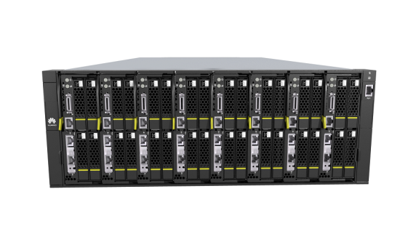
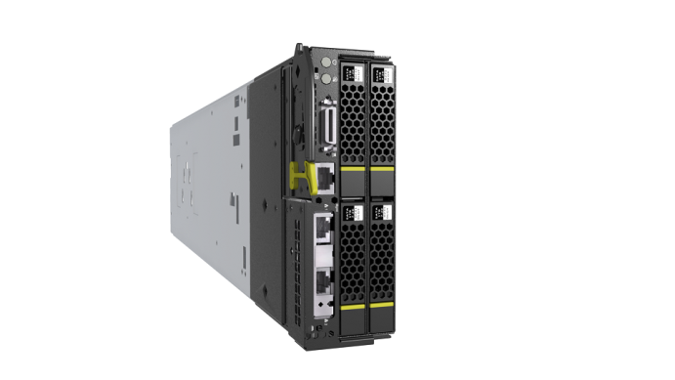
XH620 V3 2-Socket Compute Node
Form factor | Single-slot 2-socket server node
Number of CPUs | One or two
CPU model | Intel Xeon E5-2600 v3/v4
DIMM slot | 16 DDR4 DIMM slots, supporting a maximum memory capacity of 1024 GB
Number of hard disks | Two 2.5-inch SAS/SATA HDDs, Or four 2.5-inch SAS/SATA HDDs, Or two 2.5-inch SAS/SATA HDDs + two NVMe SSD HDDs, orrtwo 3.5-inch SAS/SATA HDDs
LOM network port | (Optional) 2xGE、4xGE、2x10GE、2xGE+2x10GE、2x10GBase-T or 2x56G IB
RAID support | RAID 0, 1, 10, 5, 6, supporting a supercapacitor
PCIe expansion capacity | Up to three PCIe expansion slots: one front half-height half-length PCIe 3.0 x8 slots, one rear half-height half-length PCIe 3.0 x8 slots, and one RAID controller card.
Onboard storage medium | Two Mini SSDs(SATA DOMs) and one USB flash drive
Front port | One high-density port (one VGA port, three USB 2.0 port, and one serial port), and one GE management network port
Operating temperature | 5℃ to 40℃
Dimensions (H x W x D)
XH620 V3 appearance
Exterior of the XH620V3
Node
Highlights
Space saved: A high-density 4U8 architecture reduces the equipment footprint by 50%.
Leading performance: A 4U chassis can hold eight XH620 V3 server nodes that support up to 288 CPU cores and 576 threads. Each XH620 V3 supports Intel's hyper-threading technology, boosting performance for multithreaded applications.
Notes:
Now, let's look at the specifications of XH620 V3. A 4 U X6800 chassis can house eight XH620 V3 server nodes with up to 16 CPUs, high computing density, and 50% less cabinet space compared with conventional 1 U rack servers. XH620 V3 supports three flexible configurations:
2 x 2.5-inch SAS HDDs, SATA HDDs, or SSDs at the front + 1 x standard HHHL PCIe card
4 x 2.5-inch SAS HDDs, SATA HDDs, or SSDs at the front
2 x Built-in 3.5-inch non-hot-swappable SATA HDDs

Slide 14
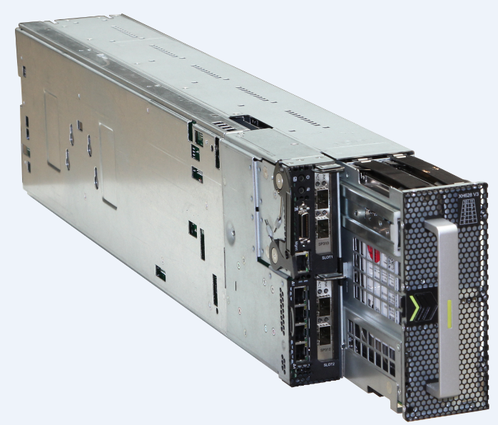
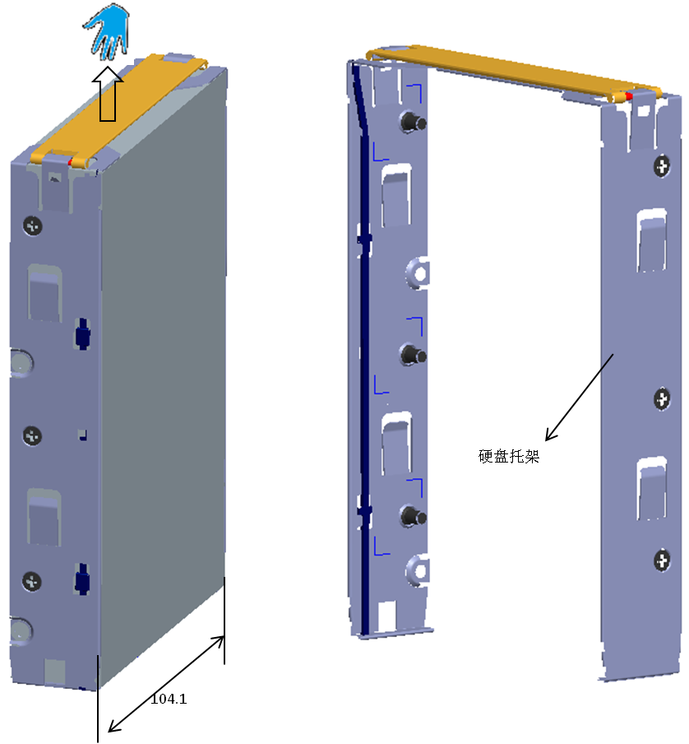
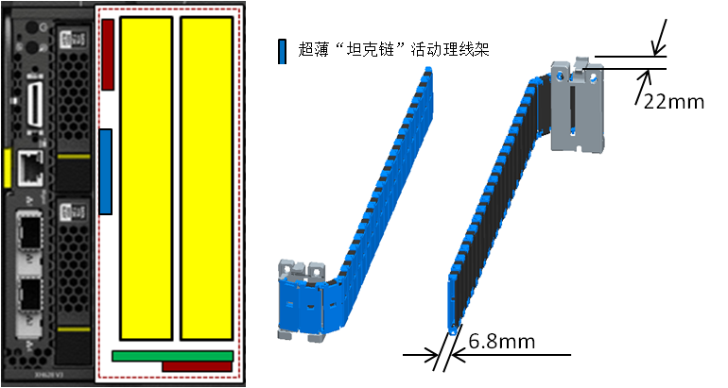
Feature (1): Ultra High Density Design, Requiring 50% Less Space than Conventional Rack Servers
6.8 mm ultra-thin cable carrier
6.9 mm guide rail
thinnest in the industry
Ultra-thin hard disk tray
Hard disk pull-type guide rail
Cable carrier
Hard disk baseboard
Ultra-thin hard disk tray, over 3 mm thinner than the industry average; hard disk density 20%-50% higher than similar products in the industry
Ultra-thin cable carrier and the industry's thinnest guide rails, space multiplexing for the cable rack and guide rails
Guide rails are installed on the left side and at the bottom of the disk enclosure, reducing the space for four guide rails per chassis.
Notes:
Just now we have talked about the high-density design of X6800 and its space being half of rack servers. Now, let's see how the high-density design is implemented.
An XH628 V3 node has two columns and six rows of hard disks from front to rear. The six rows of hard disks must be drawn out for hot-swap maintenance. You can pull out the entire chassis and open the chassis cover to maintain the hard disks. However, the entire chassis is heavy and difficult to draw out. In addition, the maintenance of one node will affect the integrity of the ventilation channels of other nodes. Therefore, the X6800 adopts an innovative design to enable hot swap of disk enclosures, leading to small maintenance granularity and higher service reliability.
1. The X6800 uses the thinnest guide rails in the industry to support disk enclosure insertion and removal and use the cable carrier to ensure the interconnection between hard disks and the mainboard. The cable carrier and guide rails share space.
2. Traditionally, guide rails are installed on the left and right sides of a disk enclosure. In the X6800, pull-type guide rails are installed on only one side and at the bottom of the disk enclosure. For a 19-inch chassis, the thickness of four pull-type guide rails can be reduced from the chassis width.
3. The X6800 uses super-thin hard disk trays.

Slide 15
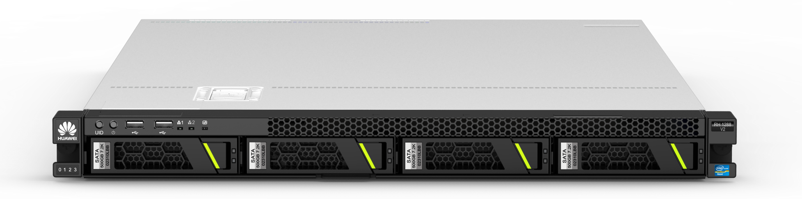
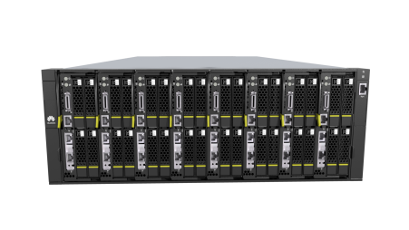
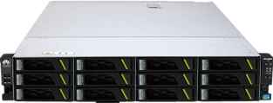
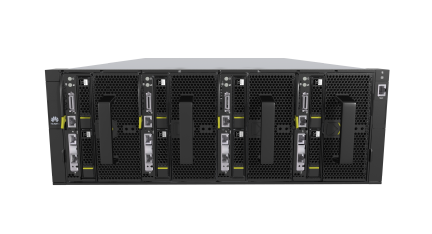
Feature (1): High-density(storage, compute)
Compute Node（4U8)
=
Equivalent of eight 1U rack-optimized servers
Saving space more than 50%
=
Storage Node(4U4）
Equivalent of four 2U rack-optimized servers
Notes:
With a high-density design, a 4 U 4-node X6800 server is equivalent to four 2 U rack servers with the same configurations. However, the space occupied by the X6800 is reduced from 8 U to 4 U, that is, a 50% reduction. The density is twice that of general-purpose rack servers.

Slide 16
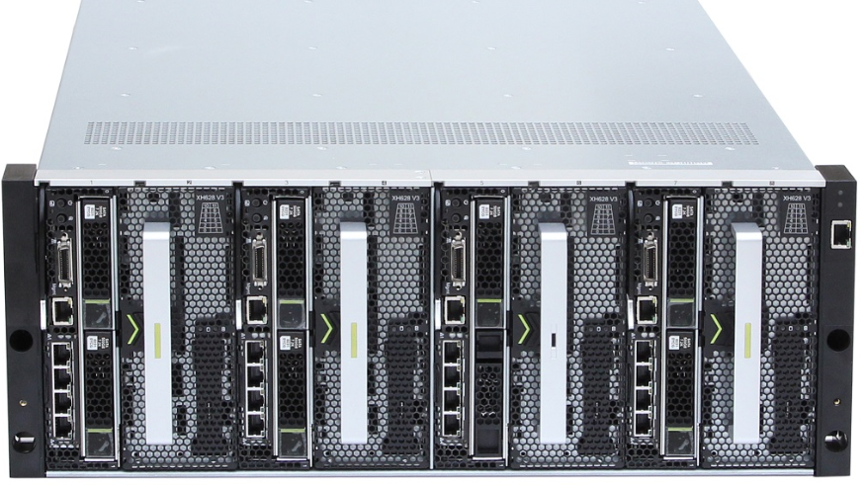
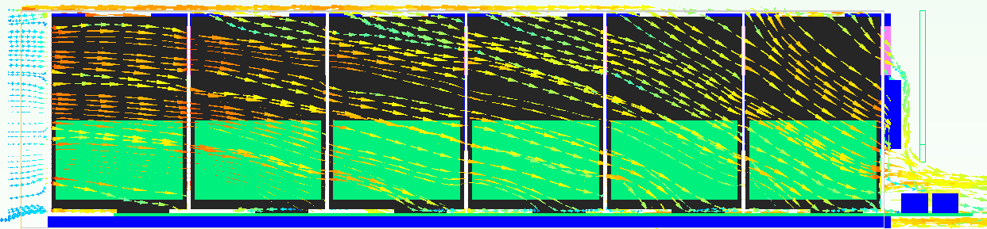


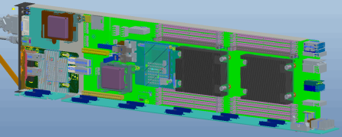
Feature (2): Optimal Heat Dissipation, Stable Operating at 40ºC
Node front
Node rear
Between the top cover and the guide rail securing board
1.8 mm gap
10 mm gap above guide rails
Front main air flow
2 mm gap below hard disks
Centralized heat dissipation design
Counter-rotating fans with high wind pressure
Cellular board
Temperature sensor
Up to 4500 W heat dissipation power
Up to 66% porosity rate
Hotspot full coverage, accurate speed adjustment
Airflow amount 10% up
Notes:
The X6800 server houses a high density of hard disks. If heat dissipation is not effective, hard disks will be easily damaged due to high temperature. Now, let's see how the X6800 operates stably at 40℃ with such a high density of hard disks and its heat dissipation design.
First, let's see the main air flow coming from the front, that is, the dark brown part in the figure. It implements heat dissipation for the first several rows of hard disks. Then, the upper-layer ventilation channels, that is, the green part in the figure. Under the top cover, there is a guide rail securing board and there is only a 1.8 mm gap between the two. This gap is critical. It supplies cool wind to the three rows of hard disks at the rear and reduces their temperature by 3℃ to 4℃. Next, this is a minor but important ventilation channel. For heat dissipation, every ventilation space is important. See the dark yellow part in the figure. The 10 mm space above the guide rail supplies cool wind for the last two rows of hard disks. There is a 2 mm gap between the hard disks and board. The air flows through the bottom enable the bottom for heat dissipation.
The effective centralized heat dissipation design of the X6800 delivers a heat dissipation efficiency of up to 4500 W. Compared with the conventional single fan, the counter-rotating fans of the X6800 increase the input airflow amount by 10%. The X6800 uses the cellular panel to increase the porosity rate and uses the temperature sensor covering all hotspots to enable intelligent fan speed adjustment based on the ambient temperature for energy conservation. For example, low fan speed at a low temperature.
Note:
The XH628 V3 node contains a hard disk array consisting of two columns and six rows. If the ambient temperature is 40ºC and air is ventilated from front to back, the temperature of the first hard disk is 44ºC. Affecting by the first hard disk, the temperature of the next disk will be 3ºC higher, and so on. Then, the last two hard disks will be over 55ºC. If heat dissipation is not optimized, the last hard disks will be easily damaged due to high temperature. The 3D heat dissipation of the X6800 prevents the hard disks at the rear from being damaged due to high temperature.

Slide 17
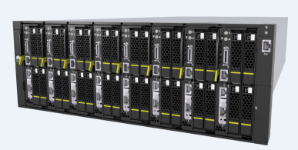
Feature (3): Rapid Deployment
8 1U rack server need 8 management network cables, 8 power cables and 8 chassis
Eight XH620 V3 nodes only need 1 management network cable, 4 power cables and 1 chassis, deployment efficiency improved by 1 time.
×
power
power
×
switch
switch
management network cable
management network cables
X6800
1U rack server
Notes:
Feature 4: Rapid deployment and service rollout. Compared with conventional rack servers, the 4 U multi-node architecture of the X6800 reduces the number of power and network cables used. To deploy four servers, the X6800 requires only one chassis, four power cables, and one network cable, while a conventional rack server requires four chassis and at least eight power cables and four network cables. Therefore, the X6800 allows easy and rapid deployment and increases overall efficiency. As indicated by data, the deployment efficiency of the X6800 is over two times that of conventional rack servers.

Slide 18

Feature (4): Easy Management
Aggregated management network port
Supports a traditional point-to-point ode management and out-of-band aggregation management.
Supports hot-plug server nodes, PSUs, and fans.
Supports IPMI v2.0, SNMP V3, and CIM, and connects to an upper-layer management platform.
Supports a network controller sideband interface (NCSI) and reduces the cost.
Management network
…
Node
Node
Node
X6800 Chassis
Node management network port
Notes:
Feature 5: Simplified management and easy O&M. The X6800 provides an aggregation management network port, through which a user can manage multiple server nodes in the chassis. This reduces the number of network cables and simplifies management. The X6800 supports point-to-point management. A user can manage each server node individually through the management port on the front of the server node. The X6800 also supports hot swap of key components, facilitating O&M. The X6800 supports standard protocols, such as IPMI v2.0, SNMPv3, and CIM, and can connect to an upper-layer management platform. This facilitates integration with third-party management systems. In addition, the X6800 supports Network Controller Sideband Interface (NC-SI), which allows users to perform centralized management through service ports and eliminates the need for switch ports and management cables.

Slide 19
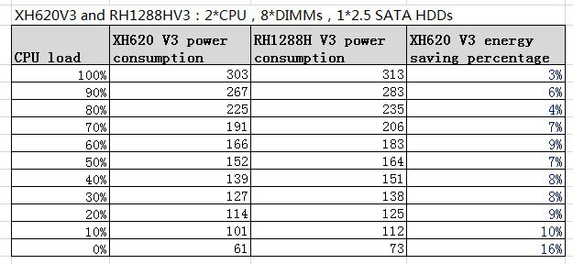
Feature (5): Power saving（XH620 V3 VS RH1288）
According to the test, the average power consumption of XH620 V3 is 8% lower than of RH1288H V3 with the same configuration.

Slide 20
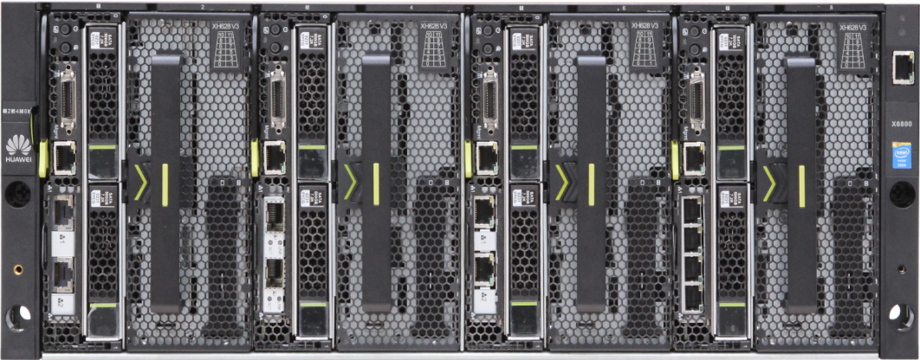
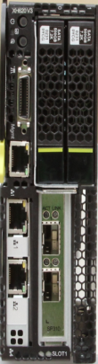

Feature (6): Mixing nodes in chassis（Solution for SMB and ROBO ）
Typical SMB Configuration 1：
3* XH628 V3 nodes for ServerSAN
2* XH620 V3 nodes for WebUI
Typical SMB Configuration 2：
2* XH628 V3 nodes for Exchange
2* XH620 V3 nodes for WebUI
Integrated deployment(software + hardware), suitable for the pre-installed sotware SMB solution
Compute and storage node can be mixed in one chassis, meeting more service requirements
4U Chassis, easy to expand nodes and hard disks
Notes:
Small- and Medium-sized Businesses (SMBs) refer to small- and medium-sized enterprises with limited operation scale, employees, and fund.
Remote Office and Branch Offices (ROBOs) refer to small-scale remote offices and branch offices of large companies.
SMB:Small and Medium Businesses 中小企业
分支机构放3-5台
Exchange CiB （cluster in a box）
预装软件上与机架无区别，只是在部署上

Slide 21

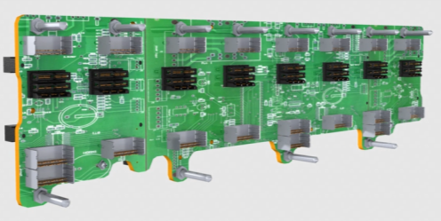
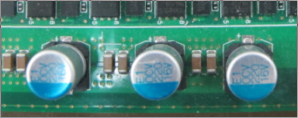
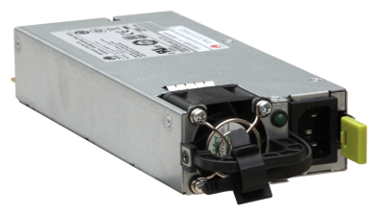
Feature (7): Reliable Service Operation
Passive backplane
Connects the server nodes to the management boards, rear I/O module, fan modules, and PSUs, preventing single point of failures.
Shock absorption design for hard disks
Stainless steel hard disk tray + shock absorption sponge
Fan modules with elastic structures
Long distance between hard disks and fan modules
Long-life component
Performs strict component selection and adopts a derating design to prolong the service life.
Uses macromolecular components instead of electrolyte to improve reliability.
Redundancy of key components
Adopts a redundant design for the key components, such as hard disks, fan modules, and PSUs to improve system reliability.
Notes:
Feature 3: Specializing in design, achieving long-term stable and reliable service running. Passive backplanes are used for reliability. Compared with economic active backplanes, passive backplanes have more layers and are more reliable. In addition, the X6800 adopts the shock absorption design to ensure a low hard disk fault rate. The design consists of three parts: 1. The hard disk tray is made of stainless steel and shock absorption sponge, effectively improving the hard disk shockproof capability. 2. Fan modules adopt elastic structures to reduce the magnitude of the vibration source. 3. Hard disks and fan modules are placed far from each other to extend the vibration transmission path and reduce the vibration transmission capability. According to the statistics of hard disk vendors, the return ratio of Huawei hard disks is lower than the industry average. As for components, Huawei strictly controls component quality and adopts the derating design to extend component lifespans. As for supplier and component model selection, Huawei abides by the TQRDCES rule for comprehensive assessment. TQRDCES stands for technology, quality, response, delivery, costs, environment, and safety. Currently, most server vendors choose server components based on the IT product derating standards, but Huawei chooses server components based on the telecom product derating standards. Therefore, Huawei server products are more stable and withstand longer lifespans. In addition, the X6800 supports redundancy of key components to improve service system reliability.

Slide 22
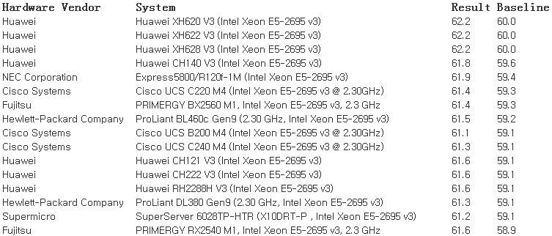
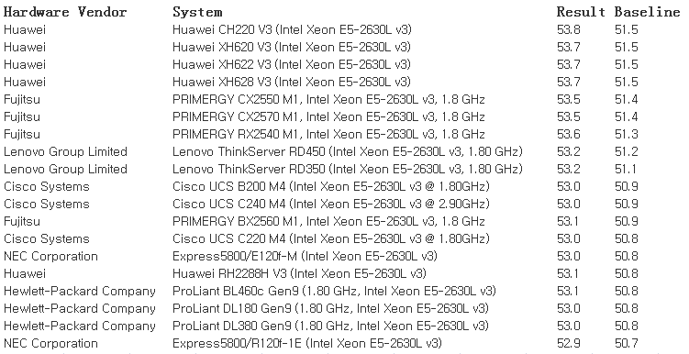
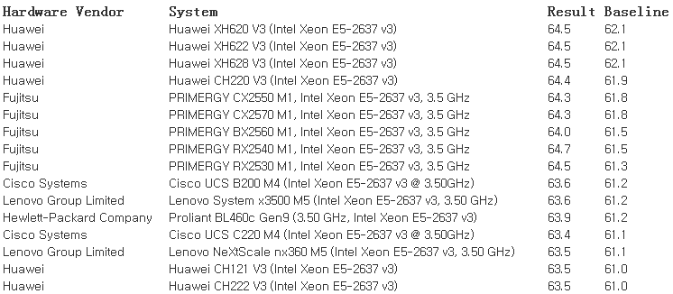
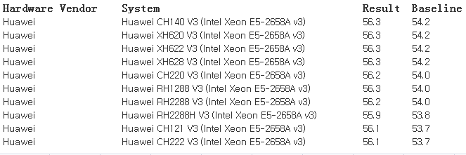
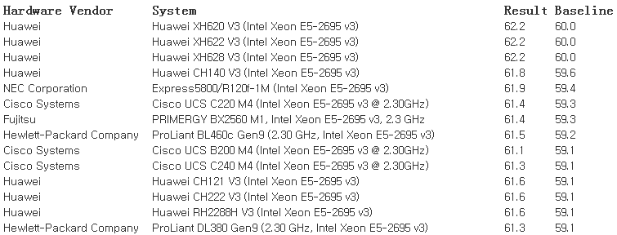
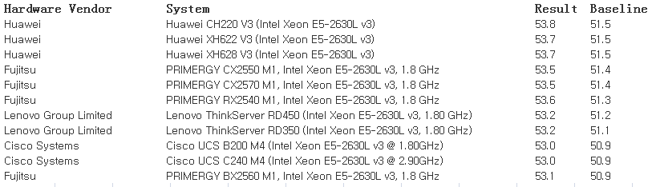
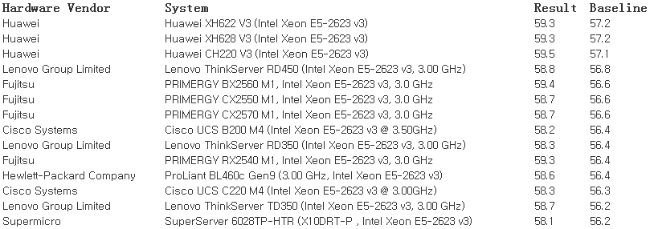
Ranked No.1 In SPEC CPU 2006 Performance Test
Year of 2015
Link：
http://www.spec.org/cpu2006/results/res2015q3/cpu2006-20150713-37168.html
http://www.spec.org/cpu2006/results/res2015q2/cpu2006-20150324-35631.html

Slide 23
Contents
1
Trends and Positioning
2
Introduction to the X6800
3
Application Scenarios and Cases

Slide 24
Server SAN
The X6800 features large storage capacity, quick deployment, flexible expansion, low power consumption, and simple maintenance and supports deployment on a large scale.
SAN
Server SAN
Server 1
Server 2
Server N
Server
Server
Server
APP
APP
APP
...
Switch
Distributed Storage Pool
Storage
Storage
Storage
HDD
HDD
HDD
Notes:
The traditional Storage Area Network (SAN) separates computing and storage resources, and the traditional SAN provided by IBM, Oracle, EMC (IOE for short) monopolized the IT market. (IBM is a server provider, Oracle a database software provider, and EMC a storage device provider.) However, in the cloud computing era, IOE cannot meet requirements of elastic cloud service scale-out, either application requirements or high construction and maintenance costs. Therefore, the converged system with standard x86 server and storage software emerges, which is named software-defined storage, implementing the integration of computing and storage. The system is also called Server SAN by the Wikibon. In brief, the server SAN is a storage resource pool consisting of multiple independent server storage resources, providing a high cost-effectiveness and scalability.

Slide 25
Big Data (Hadoop)
Hadoop is a distributed system infrastructure developed by the Apache Software Foundation. The core of Apache Hadoop consists of the Hadoop Distributed File System (HDFS) and MapReduce. The HDFS provides storage resources and the MapReduce provides computing resources for a large amount of data.
Hadoop requires the nodes used provide storage and computing at the same time.
Hadoop is generally deployed on a large scale. The large-scale deployment of Hadoop using traditional rack servers requires high cost, provides slow deployment and comprehensive maintenance, and is hard to expand. Therefore, the X6800 is ideal for the large-scale deployment as it can reduce rental, decrease energy consumption, and provide quick deployment, flexible expansion, high storage capacity, and easy maintenance.
HDFS
Client
NameNode
Secondary
NameNode
DataNode
(XH628)
DataNode
(XH628)
DataNode
(XH628)
DataNode
(XH628)
X6800
Notes:
Before Hadoop, high-performance computing and grid computing are always mainly used to solve Big Data problems. For the traditional architecture whose computing and storage resources are separated, when accessing of data at the PB level, many computing nodes in clusters can only be idle for waiting due to the limit of storage network bandwidth. Hadoop solves this problem. Using a file system Hadoop Distributed File System (HDFS) intended for the distributed computing, Hadoop only need to push computation codes to storage nodes, and the data calculation will be completed on the storage nodes. Cluster storage nodes in Hadoop are also compute nodes.
The core of Hadoop consists of Hadoop Distributed File System (HDFS) and MapReduce. The HDFS provides storage resources and the MapReduce provides computing resources for a large amount of data.

Slide 26
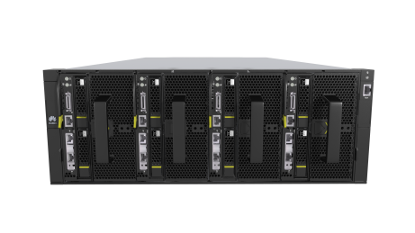
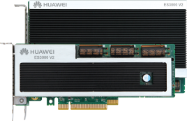
PCIe SSD Acceleration
X6800 Supports a maximum of four HHHL Huawei ES3000 PCIe cards per node.
X6800 server
PCIe SSD card
+
=
The high I/O storage server meets the service requirements for high concurrent I/O performance and high I/O throughput bandwidth.

Slide 27



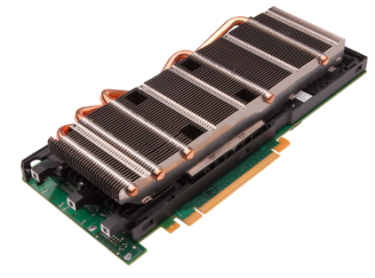
GPU Acceleration
Supports a maximum of two dual-slot GPUs per node.
Supports the Intel Xeon-Phi acceleration card.
CPU
GPU
Hotspots
Potential applications
  Operating systems
  Recursive algorithm
  Desktop applications:
    Microsoft Word
  Interactive application
    Debugger
    …
Oil and gas exploration
Financial analysis
Medical imaging
Finite element
Genetic analysis
Physical simulation
Geographic information system
3D cloud computing
Video encoding
Search engine
Database and data mining
Statistical analysis
Biomedical engineering
Navigation
Military simulation
RF simulation
Video and audio recognition
Notes:
The GPU application solution accelerates HPC. The XH622 V3 is developed for HPC acceleration. It supports two high-performance dual-slot GPGPUs or Intel Xeon-Phi cards, meeting the GPU acceleration requirements of the HPC fat node. For the GPU models supported by the XH622 V3, see the Technical White Paper for the XH622 V3.

Slide 28

Superior-Performance High-Density XH620 V3
Helps Germany Mercedes-Benz CAE System in Designing New C Series Models
"I believe you can make it. You are now a vendor with the top benchmark."
- Germany Mercedes-Benz
Notes:
Challenges:
As the world's top automotive brand, Germany Mercedes-Benz is the world's largest luxury car manufacturer, largest commercial vehicle manufacturer, and No. 17 among the world's top 500 companies.
Mercedes-Benz becomes more and more dependent on the CAE technology for aided design during car design and development, for example, car appearance design, aerodynamic shape simulation, and crash simulation.
Mercedes-Benz's existing HPC system cannot meet CAE requirements. Mercedes-Benz has an urgent need to improve its system performance and enable its system to meet higher requirements on power consumption, reliability, etc.
Solution:Huawei provides an all-in-one HPC solution with over 100 X6800 high-density server nodes to help Mercedes-Benz improve its HPC system performance.
The 4 U X6800 server supports eight XH620 V3 compute nodes, Intel Xeon E5-2600 v3 full series processors, and up to 1 TB memory capacity. It delivers superior computing performance and density.
The X6800 uses shared PSUs and fan modules, innovative ventilation channels to reduce system power consumption and support long-term stable running at 40ºC.
Customer Benefits
HPC test performance 50% up, greatly improving CAE system efficiency
Power consumption 10% down, effectively reducing electricity charges
Server density 50% higher than that of conventional rack servers, requiring less equipment footprint

Slide 29

Large-Capacity High-Density XH628 V3
Helps India Flipkart Establish a Hadoop Storage Resource Pool
www.flipkart.com
"Huawei servers' superior performance, large storage capacity, and high density help Flipkart a lot in Hadoop deployment."
Notes:
Challenges:
High density and large capacity: PB-level data , quick data search, easy expansible distributed file system, single node with a capacity of over 48 TB.
Low power consumption: Flipkart has deployed hundreds of servers and faces an electricity cost up to millions of dollars each year. It has very high requirements on the power consumption raised by the server platform.
High stability: Server downtime will cause performance deterioration or service suspension and lead to direct and potential revenue loss. High stability is critical to Flipkart.
Fast deployment: With its rapid development, Flipkart has a requirement for a large number of servers each year and requires the servers to arrive within three weeks to meet service provisioning requirements.
Solution:
High-density design, 50% less equipment footprint than rack servers, 4 U for accommodating 48 3.5-inch disks, up to 296 TB storage capacity per chassis (74 TB per node), high scalability.
Power supply modules and fan modules are shared by servers, offering higher power conversion efficiency compared with traditional rack servers. Provides innovative design, excellent heat dissipation, and long-term operating at 40℃. Adopts Huawei Dynamic Energy Management Technology (DEMT) for power consumption management to reduce the power consumption of the system.
The product performance and reliability have passed the Flipkart POC test. The power supply modules, fan modules, and hard disks are hot swappable.
Architecture shared by power supply modules and fan modules; modular deployment of components; more than 2-fold increase (even higher for XH620 V3 nodes) in the deployment efficiency over traditional rack servers.
Value:
High reliability：Fault rate is decreased and batch failure problems are solved successfully;
Rapid deployment：Efficiency is increased with deployment by chassis;
Space saving: High density designed and save space by 50% and power consumption by 10%;

Slide 30
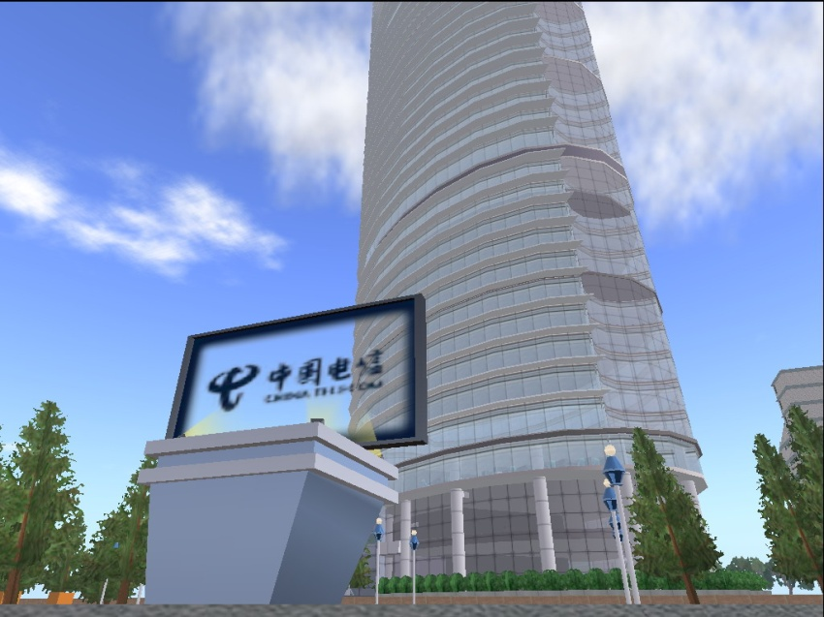
Large-Storage-Capacity XH628 V3
Helps China Telecom Constructs a Big Data Platform
"Huawei X6800 data center servers feature flexible architecture, diversified nodes, and ease of use, and are ideal for cloud data center infrastructure."
- China Telecom
Notes:
(China Telecom purchased Huawei X6800s for big data and server SAN applications to reduce its energy and power consumption.)
The X6800 is very helpful for constructing a large cloud data center. In this case, we will introduce how do X6800 servers help China Telecom construct a big data platform. China Telecom is one of the major three telecom carriers in China. In 2013, Fortune rated it the number 182 among the top global 500 companies. China Telecom is devoting to developing its cloud and big data services which require a large number of servers and storage devices. Due to high costs of servers with external storage, China Telecom is gradually inclining towards servers with large local storage capacity. In addition, China Telecom has high requirements for server density and power consumption due to its limited equipment room space and needs of large number of servers. The X6800 features high density and low power consumption. China Telecom purchases 200 chassis at one time, total 800 nodes for big data storage and analysis systems. With the X6800, the equipment room space is saved by 50%, power consumption reduced by 10%, system efficiency improved, and service rollout period shortened. There are not many cases for the X6800 that is marketed recently. We will provide more in the future.

